Slide 1

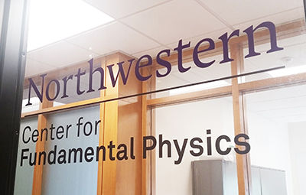

ZOMBIES: an experiment to measure nuclear anapole moments
(and more)
Nuclear anapole moment and hadronic parity violation
Nuclear spin-dependent parity violation (NSD-PV) in atoms & molecules: nuclear anapole moment + semi-leptonic
ZOMBIES approach using amplified NSD-PV effect in molecules
Proof of principle with ¹⁹F in BaF molecules
Outlook
Dave DeMille
University of Chicago & Argonne National Laboratory
Funding:
Notes:
Needed: --more pictures of apparatus!
--show some data!

Slide 2
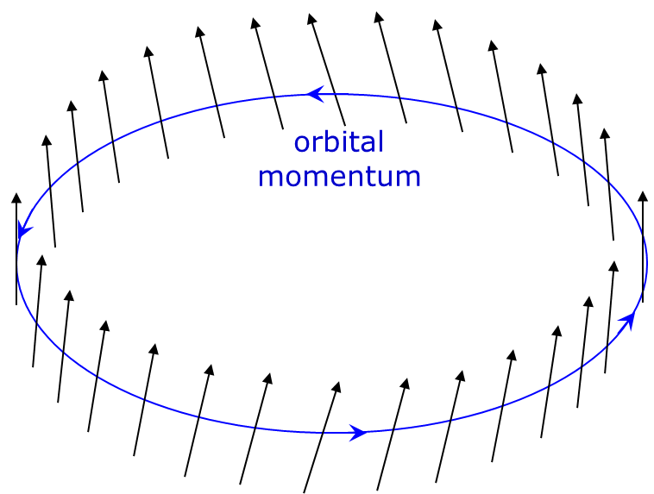
Purely hadronic PV in nucleus induces nuclear spin helix = anapole moment
nucleon spin tilted
along momentum

Slide 3
Purely hadronic PV in nucleus induces nuclear spin helix = anapole moment
nucleon spin tilted
along momentum
Current loop
(dipole)
=
+
Current helix
(anapole)

Slide 4
Purely hadronic PV in nucleus induces nuclear spin helix = anapole moment
nucleon spin tilted
along momentum
Current loop
(dipole)
=
+
Current helix
(anapole)
Simple model for nuclear anapole
(valence nucleon + constant-density core):

Slide 5
Microscopic physics of nuclear anapole moment
Nucleon-nucleon hadronic parity-violating (HPV) interactions perturb nuclear structure:
N₁
N₁’
W
S
DDH description of HPV: effective meson exchange parameterizes range & isospin structure
π, ρ, ω
S
W
N₂
N₂’
Hamiltonian for unpaired nucleon interacting with paired core gives spin-momentum correlation
Describe low-energy HPV with 6 dimensionless coupling constants,
each associated with different spin/isospin structure & range

Slide 6
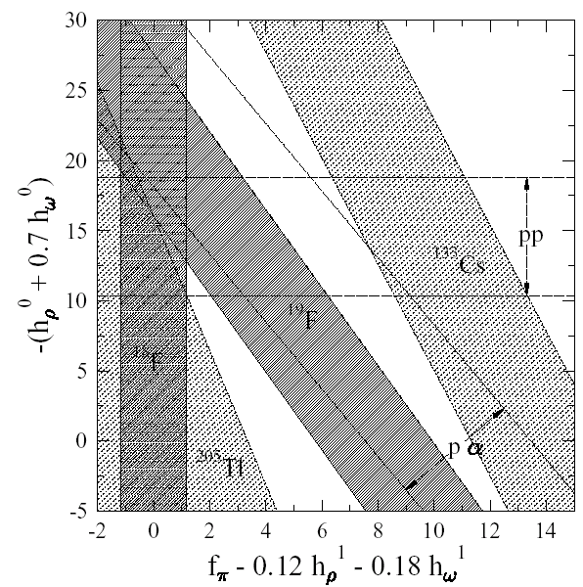
HPNC measurements including anapole moments (prior to ~2018) in 2-D slice of DDH parameters
Single prior
anapole measurement from atomic PV in ¹³³Cs
[C. Wieman group, JILA, 1997]
Poor agreement with all other data (nuclear theory problem…?)
Assumes ~30% uncertainty in nuclear structure calculations

Slide 7
HPNC measurements including anapole moments (prior to ~2018) in 2-D slice of DDH parameters
Odd-n
isotopes
Single prior
anapole measurement from atomic PV in ¹³³Cs
[C. Wieman group, JILA, 1997]
Assumes ~30% uncertainty in nuclear structure calculations

Slide 8
HPNC measurements including anapole moments (prior to ~2018) in 2-D slice of DDH parameters
New odd-p
isotopes
Odd-n
isotopes
Single prior
anapole measurement from atomic PV in ¹³³Cs
[C. Wieman group, JILA, 1997]
Assumes ~30% uncertainty in nuclear structure calculations

Slide 9
HPNC measurements including anapole moments (prior to ~2018) in 2-D slice of DDH parameters
New odd-p
isotopes
Odd-n
isotopes
NOTE:
anapole moments not yet evaluated in new EFT parameterization & large N_{c} analysis of HPV
Single prior
anapole measurement from atomic PV in ¹³³Cs
[C. Wieman group, JILA, 1997]
See M. Sarsour talk this session
Assumes ~30% uncertainty in nuclear structure calculations

Slide 10
Mechanisms for nuclear spin-dependent parity violation in atoms and molecules
e
σ_{e}
γ
I
N
Z⁰, W±
HPV interactions
inside nucleus induce
nuclear anapole moment:
couples magnetically
to penetrating electron

Slide 11
Mechanisms for NSD-PV in atoms and molecules
e
e
V_{e}+A_{e}
σ_{e}
γ
+
Z⁰
I
V_{N}+A_{N}
N
N
Z⁰, W±
Tree-level
NSD-PV
from suppressed
V_{e}A_{N} term:
C₂ subject to QCD renormalization similar to g_{A}
HPV interactions
inside nucleus induce
nuclear anapole moment:
couples magnetically
to penetrating electron

Slide 12
Mechanisms for NSD-PV in atoms and molecules
e
e
e
V_{e}+A_{e}
A_{e}
σ_{e}
σ_{e}
γ
+
+
γ
Z⁰
Z⁰
I
V_{N}+A_{N}
V_{N}
I
N
N
Z⁰, W±
N
Tree-level
NSD-PV
from suppressed
V_{e}A_{N} term:
C₂ couplings subject to QCD renormalization analogous to g_{A}
HPV interactions
inside nucleus induce
nuclear anapole moment:
couples magnetically
to penetrating electron
Coherent sum:
weak charge Q_{W}
and
EM hyperfine interaction (small, well-understood)

Slide 13
3 contributions to NSD-PV in atoms/molecules: scaling with Z & A
Overall Z²
κ’_{2P} = -κ’_{2N} ≈ -.05
Challenge for atomic/molecular approaches:
Signals by far easiest to detect with high Z & A
BUT
Best chance for reliable interpretation with lowest Z & A

Slide 14
3 contributions to atom/molecule NSD-PV: scaling with Z & A
Overall Z²
κ’_{2P} = -κ’_{2N} ≈ -.05
Heavy atoms/molecules→anapole term dominates:⎟κ’_{a}⎜ > ⎟κ’₂⎜
(Collective enhancement causes radiative correction > tree level…!)
Light atoms/molecules→tree-level Z exchange term dominates:⎟κ’_{a}⎜ > ⎟κ’₂⎟
⎟κ_{a}⎜ ≈ ⎟κ₂⎜ for A ≈ 10 (odd proton)
A ≈ 100 (odd neutron)

Slide 15
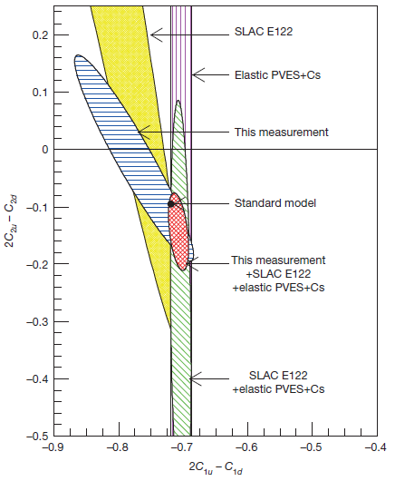
More physics motivation for κ measurements: neutral weak currents & QCD
κ₂: Tree-level Z⁰ Exchange
Vector electron – axial nucleon weak coupling constants (C_{2N}, C_{2P})
Related to fundamental electron-quark couplings (C_{2u}, C_{2d}) via QCD
Complementary to PVDIS e-p measurements at JLAB (different linear combinations of C₂’s & nucleons vs. quarks)
JLAB PVDIS Collab. Nature 506, 67 (2014)
See D. Adhikari talk this session

Slide 16
ZOMBIES overarching goal: understand electroweak interactions in strongly-interacting environment at low q²
Pure hadronic (nucleon-nucleon) parity violating interactions: still poorly understood --complementary to recent few-nucleon probes (NPDGamma, polarized n on ³He, neutron spin rotation, …) --sensitive to different linear combinations in multi-parameter space --connect to recent developments in nuclear structure calculations & HPV theory --rich data set for consistency checks -- benchmark for 0υββ matrix element calculations…???
Nucleon-level V_{e}A_{h} (C_{2P}, C_{2N}) vs. Nucleus-level V_{e}A_{h} --quenching as for g_{A} in charged currents…?
Quark-level V_{e}A_{h}(C_{2u}, C_{2d}) vs. nucleon-level V_{e}A_{h}(C_{2P}, C_{2N}) neutral current couplings ? --matching as q²→0…? --potential for lattice QCD prediction & post-hoc verification?

Slide 17
ZOMBIES principle: amplified NSD-PV mixing in molecules w/unpaired electron
J^{P} = 1⁻
J^{P} = 0⁺
Naturally small rotational splitting (~10⁻⁴ eV vs. ~1 eV in atoms)

Slide 18
Amplified NSD-PV mixing in molecules with one unpaired electron
J^{P} = 1⁻
J^{P} = 0⁺
Naturally small rotational splitting (~10⁻⁴ eV vs. ~1 eV in atoms)
can be bridged w/Zeeman shift:
 10¹¹ enhanced PV mixing vs. classic experiments with atoms

Slide 19
Stark interference method: apply oscillating E-field to mix nearly-degenerate opposite-parity levels
Center of Magnet:
Homogeneity δB/B << 10⁻⁷
E₋
E
Zeeman-shifted Energy E
E₊
Position z ∝ Time t = z/v

Slide 20
Detecting PV in near-degenerate levels: AC Stark shift
|->
|+>
D.D., S.B. Cahn, et al. PRL 100, 023003 (2008)
Nguyen et al., PRA 56, 3453 (1997)

Slide 21
Detecting PV in near-degenerate levels: AC Stark shift
PV mixing iW encodes physics of interest
|->
|+>
D.D., S.B. Cahn, et al. PRL 100, 023003 (2008)
Nguyen et al., PRA 56, 3453 (1997)

Slide 22
Detecting PV in near-degenerate levels: AC Stark shift
|->
|+>
Apply oscillating E-field, 1 cycle:
D.D., S.B. Cahn, et al. PRL 100, 023003 (2008)
Nguyen et al., PRA 56, 3453 (1997)

Slide 23
Detecting PV in near-degenerate levels: AC Stark shift
|->
|+>
Apply oscillating E-field, 1 cycle:
D.D., S.B. Cahn, et al. PRL 100, 023003 (2008)
Nguyen et al., PRA 56, 3453 (1997)

Slide 24
Detecting PV in near-degenerate levels: AC Stark shift
|->
|+>
Apply oscillating E-field, 1 cycle:
D.D., S.B. Cahn, et al. PRL 100, 023003 (2008)
Nguyen et al., PRA 56, 3453 (1997)

Slide 25
Detecting PV in near-degenerate levels: AC Stark shift
|->
|+>
Apply oscillating E-field, 1 cycle:
D.D., S.B. Cahn, et al. PRL 100, 023003 (2008)
“Large” Stark Term
Even in E₀
Small PV Term
Odd in E₀
Nguyen et al., PRA 56, 3453 (1997)

Slide 26
Signal, Asymmetry, Sensitivity

Slide 27
Signal, Asymmetry, Sensitivity

Slide 28
Signal, Asymmetry, Sensitivity
N. Fortson, PRL 70, 2383 (1993)

Slide 29
Properties of NSD-PV asymmetry: example with ¹³⁷BaF
Typical numbers for ¹³⁷BaF:
Δ ₀ ~ 1/T ~ 2π × 1 kHz
ω = 2π × 100 kHz
dE₀ /ω = 0.1
W = 2π × 5 Hz
up to
~8% asymmetry
expected for ¹³⁷BaF;
~1% typical

Slide 30

ZOMBIES experimental schematic
ablation laser pulse
Superconducting Magnet
$$𝓔$$
Electrodes
Solid Ba Target
(2)
(3)
(4)
(5)
(1)
Molecular
Beam Source
z
(1)

Slide 31
ZOMBIES experimental schematic
ablation laser pulse
Superconducting Magnet
$$𝓔$$
Electrodes
Solid Ba Target
(2)
(3)
(4)
(5)
(1)
Molecular
Beam Source
z
(2)

Slide 32
ZOMBIES experimental schematic
ablation laser pulse
Superconducting Magnet
$$𝓔$$
Electrodes
Laser
Solid Ba Target
(2)
(3)
(4)
(5)
(1)
Molecular
Beam Source
z
(3a)
(3b)

Slide 33

ZOMBIES experimental schematic
ablation laser pulse
Superconducting Magnet
$$𝓔$$
Electrodes
Laser
Solid Ba Target
(2)
(3)
(4)
(5)
(1)
Molecular
Beam Source
z
$$ℰ$$
W
(3b)
(4)

Slide 34
ZOMBIES experimental schematic
ablation laser pulse
Superconducting Magnet
$$𝓔$$
Electrodes
Laser
Laser
Solid Ba Target
(2)
(3)
(4)
(5)
(1)
Molecular
Beam Source
z
$$ℰ$$
W
(4)
(5a)
(5b)

Slide 35
ZOMBIES experimental schematic
ablation laser pulse
Superconducting Magnet
$$𝓔$$
Electrodes
Laser
Laser
Laser
PMT
Solid Ba Target
(6)
(2)
(3)
(4)
(5)
(1)
Molecular
Beam Source
Fluorescence
Collection
z
(PMT)
(5b)
(6)

Slide 36
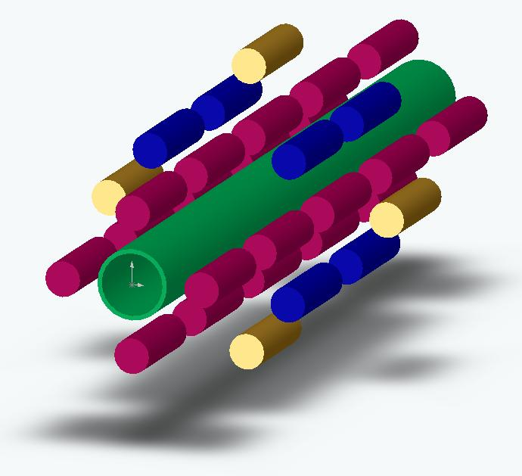
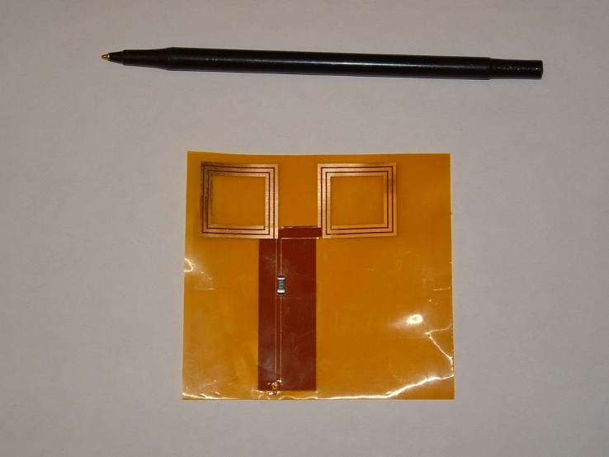
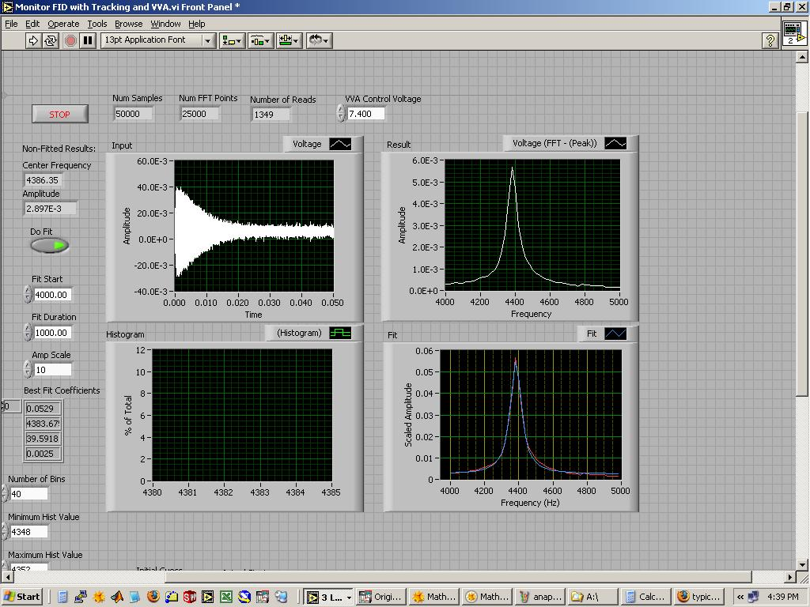
Magnetic field measurement (1st layer)
molecular beam axis
broadband probe on flex circuit
array of 32 NMR B-field probes
FID trace + FFT fit: B/B = 0.01 ppm in one 60 ms shot

Slide 37
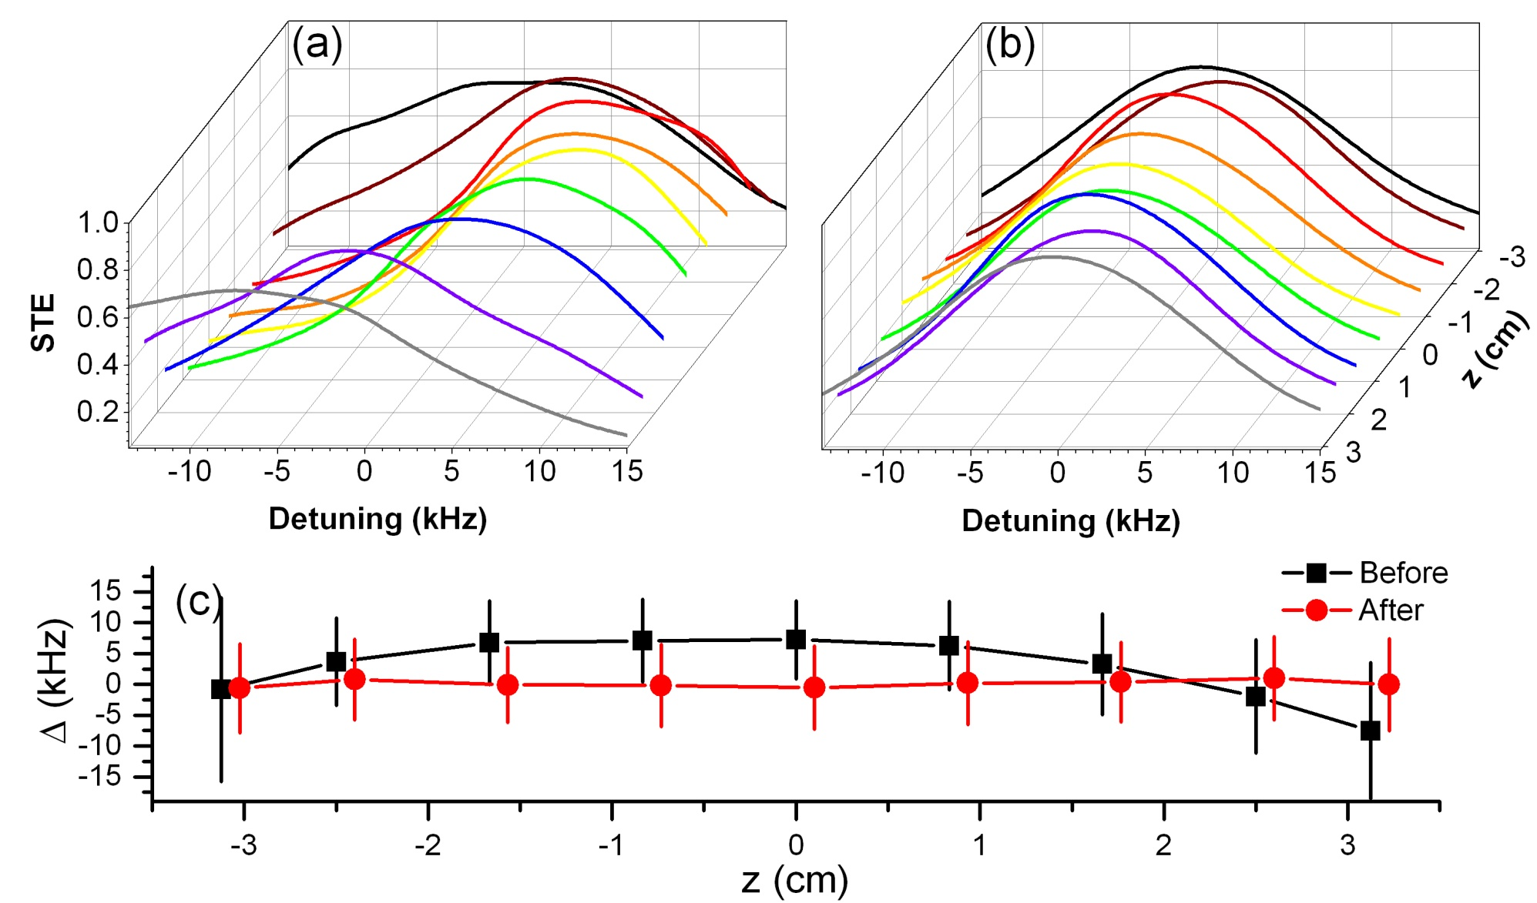
Magnetic field control (2nd layer): results with 52 shim coils
Using molecules for final measurement & shimming:
r.m.s. variation δB/B < 20 ppb [6 cm L. x 1 cm D. cylinder]

Slide 38
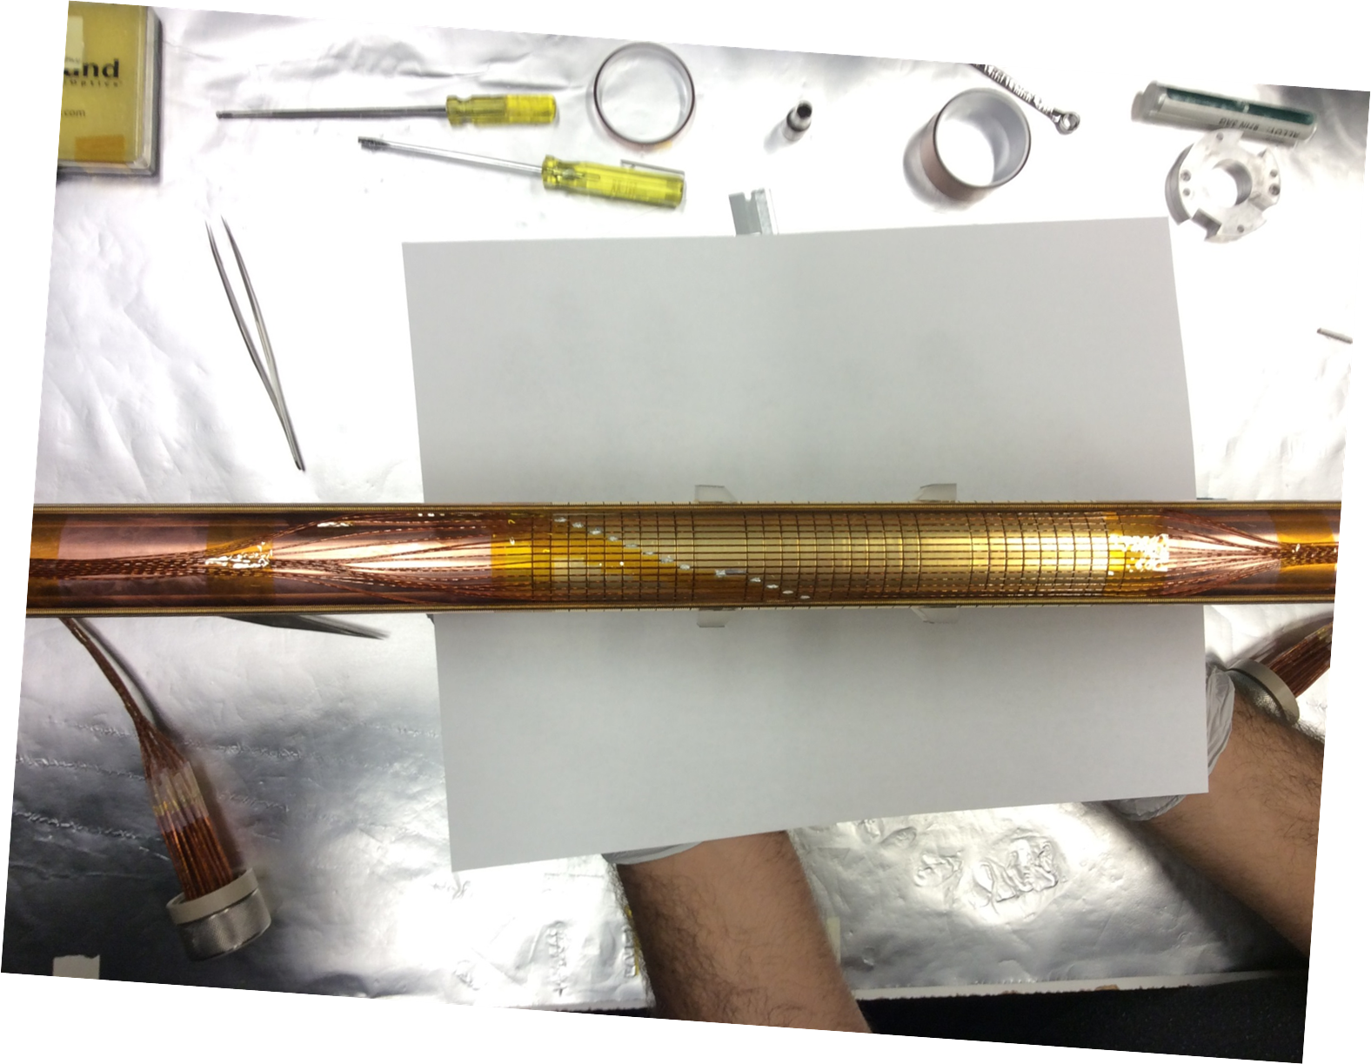
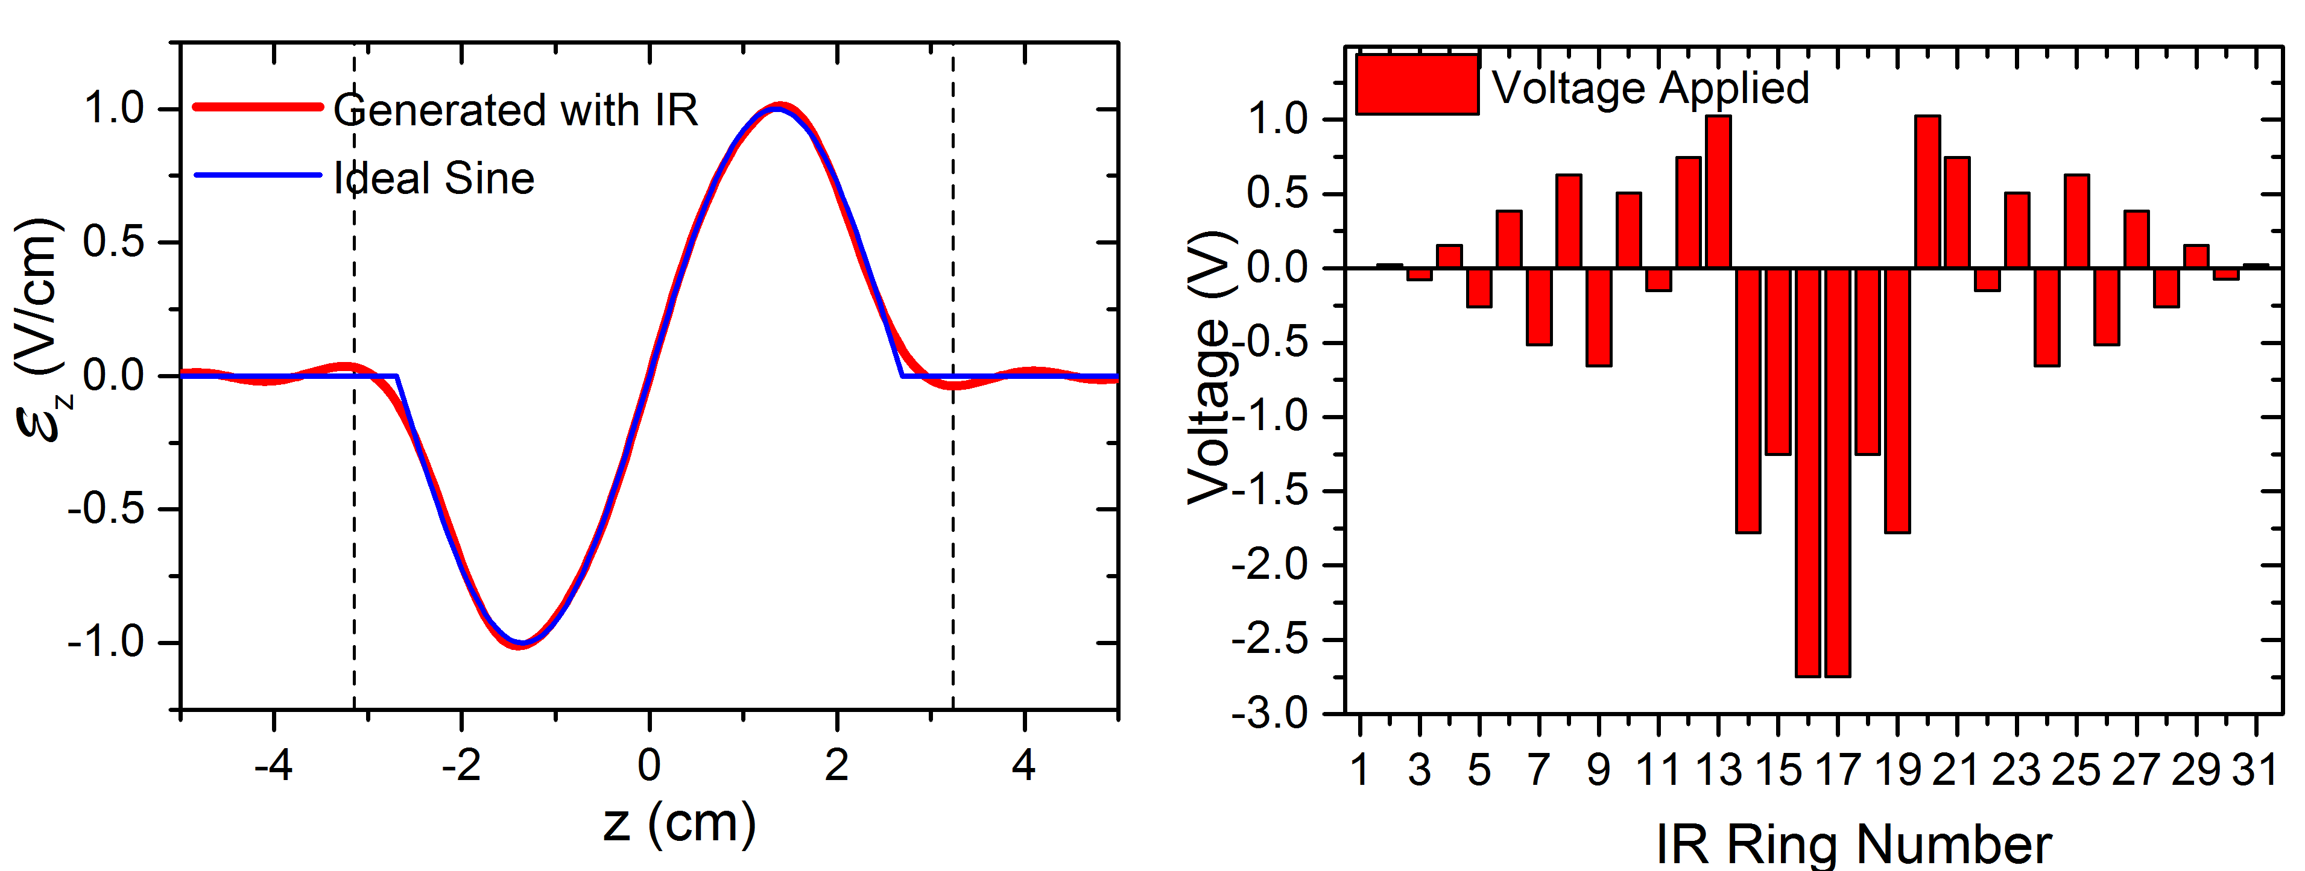
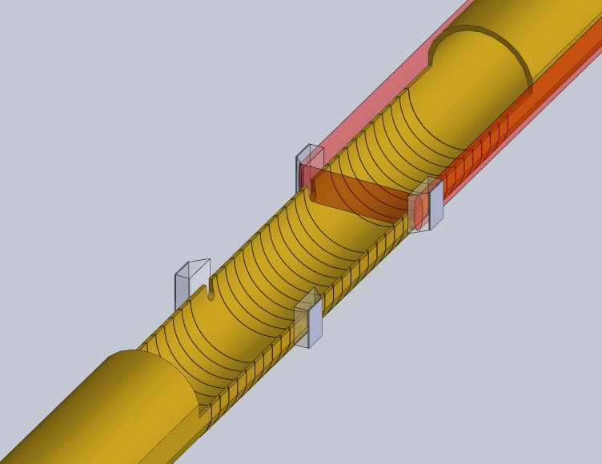
E-field control
Ring electrodes create sine wave E-field along z-axis:
Prism
Solder
Wire
in channel
Tube
Rings
Prism
Ring
Rings
Prism
Ring
Rings
Tube
Molecular beam
Laser beam

Slide 39
ZOMBIES I: NSD-PV with BaF
Ba
Initial physics goal: NSD-PV with ¹³⁷BaF
Odd neutron (vs. ¹³³Cs w/odd proton)
Heavy → large effect, anapole term dominates
Large enough natural abundance 11%
Required lasers = simple, cheap diodes
F
Completed: proof of principle using ¹³⁸Ba¹⁹F
Larger natural abundance (~75% vs ~11% for ¹³⁷Ba)
Uses same beam source, lasers, magnet, etc. as ¹³⁷BaF
W(¹³⁸Ba) = 0 Hz (no unpaired nucleons = no NSD-PV) W(¹⁹F) ≈ 0.002 Hz ≈ 0 (light, small electron spin density in BaF)
Test for practical sensitivity & systematics with known answer

Slide 40
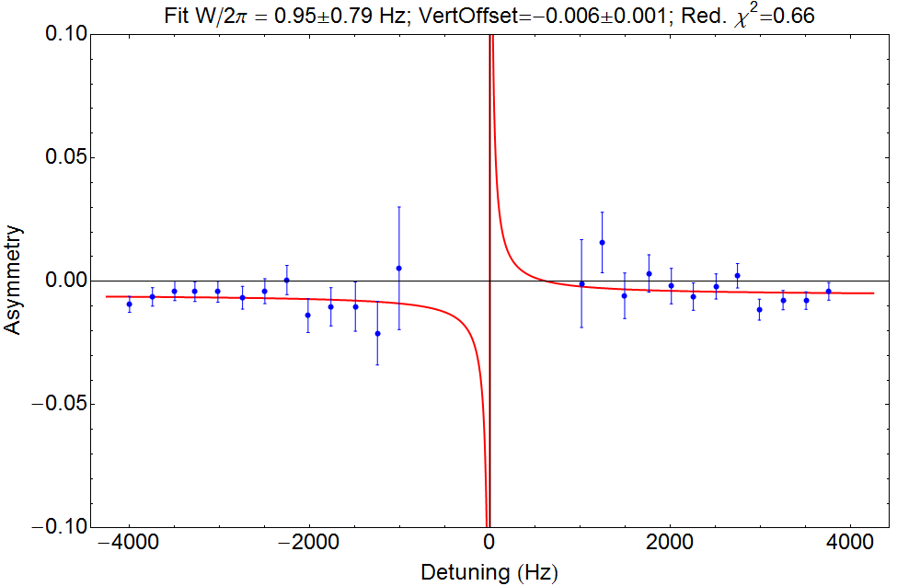
Typical asymmetry data from proof of principle run with ¹³⁸Ba¹⁹F
Null signal expected for ¹⁹F nucleus
Avg. over ~30 hours:
W/2π = -0.03±0.47 Hz
⇒ consistent w/ zero
Typical data with
Offset = 0.006±0.001
(from small stray E-field)
χ²_{d.o.f.} = 0.66
Notes:
Use best recent data!

Slide 41
Uncertainties in proof-of-principle with ¹³⁸BaF
Strategy
Deliberately exaggerate possible imperfections by known, large factor
Measure effect on the NSD-PV matrix element W from coupling to ambient imperfections in the experiment

Slide 42
Uncertainties in proof-of-principle with ¹³⁸BaF
Strategy
Deliberately exaggerate possible imperfections by known, large factor
Measure effect on extracted NSD-PV matrix element W from coupling to ambient imperfections in the experiment
Final Error Budget with ¹³⁸Ba¹⁹F
~170 h data ~6x10⁷ molecules total

Slide 43
What does the ¹³⁸Ba¹⁹F result mean?
Most useful comparison:
E. Altuntas, J. Ammon, S.B. Cahn, DD PRL 120, 142501 (2018); PRA 97, 042101 (2018)

Slide 44
What does the ¹³⁸Ba¹⁹F result mean?
Most useful comparison:
Same experimental uncertainty in ¹³⁷BaF would mean
~10% of predicted value
E. Altuntas, J. Ammon, S.B. Cahn, DD PRL 120, 142501 (2018); PRA 97, 042101 (2018)

Slide 45
What does the ¹³⁸Ba¹⁹F result mean?
Most useful comparison:
Same experimental uncertainty in ¹³⁷BaF would mean
~10% of predicted value
Compares favorably to JILA ¹³³Cs result:
C.S. Wood et al., Science 275, 1759 (1997)
E. Altuntas, J. Ammon, S.B. Cahn, DD PRL 120, 142501 (2018); PRA 97, 042101 (2018)

Slide 46
What does the ¹³⁸Ba¹⁹F result mean?
Most useful comparison:
Same experimental uncertainty in ¹³⁷BaF would mean
~10% of predicted value
Compares favorably to JILA ¹³³Cs result:
C.S. Wood et al., Science 275, 1759 (1997)
Unprecedented sensitivity to NSD-PV
General technique enables measurements in broad range of nuclei
E. Altuntas, J. Ammon, S.B. Cahn, DD PRL 120, 142501 (2018); PRA 97, 042101 (2018)

Slide 47
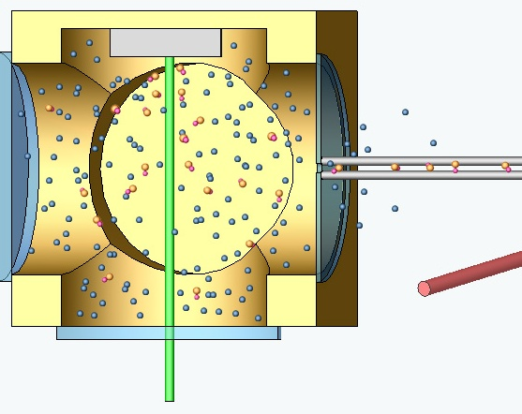
Newly added: Cryogenic Buffer Gas-cooled Beam (CBGB)
[S. Maxwell et al. PRL 2005; D. Patterson & J. Doyle J Chem Phys 2007;
J. Barry, DD, et al. PCCP 2011; N. Hutzler, DD, J. Doyle et al. PCCP 2011]
Liquid helium bath
or pulse-tube refrigerator
Inject hot molecules (e.g. via laser ablation)
Cool w/cryogenic buffer gas @ high density
Efficient extraction to beam via “wind” in cell: 10⁻⁴ → 10%-40%
“Self-collimated” by extraction dynamics
Rotational cooling in expansion: T ~ 1-4 K
Moderately slow: v ~ 200 m/s
Low velocity → interaction time ~ 3× larger;
Beam brightness ~ 2× larger flux observed SO FAR (but expected 10-100x….?)
Will enable magnetic focusing ⇒ ~ 10× flux
Gain in NSD-PV statistical sensitivity: 5x now, >30× anticipated

Slide 48
Demonstrated: Better Energy Resolution with CBGB
Level Crossing for ¹³⁸BaF: Supersonic Source Is Wide
Cryogenic Source is Narrow

Slide 49
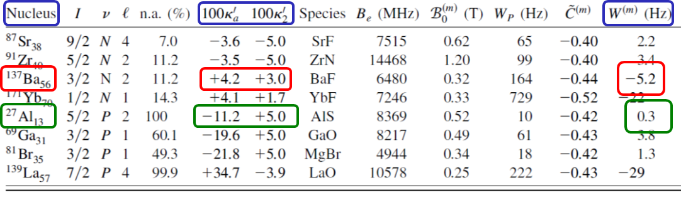
ZOMBIES: general-purpose technique, applicable to many isotopes
Improved understanding of molecular structure since 2008 → even more viable molecule species to study many different nuclei

Slide 50
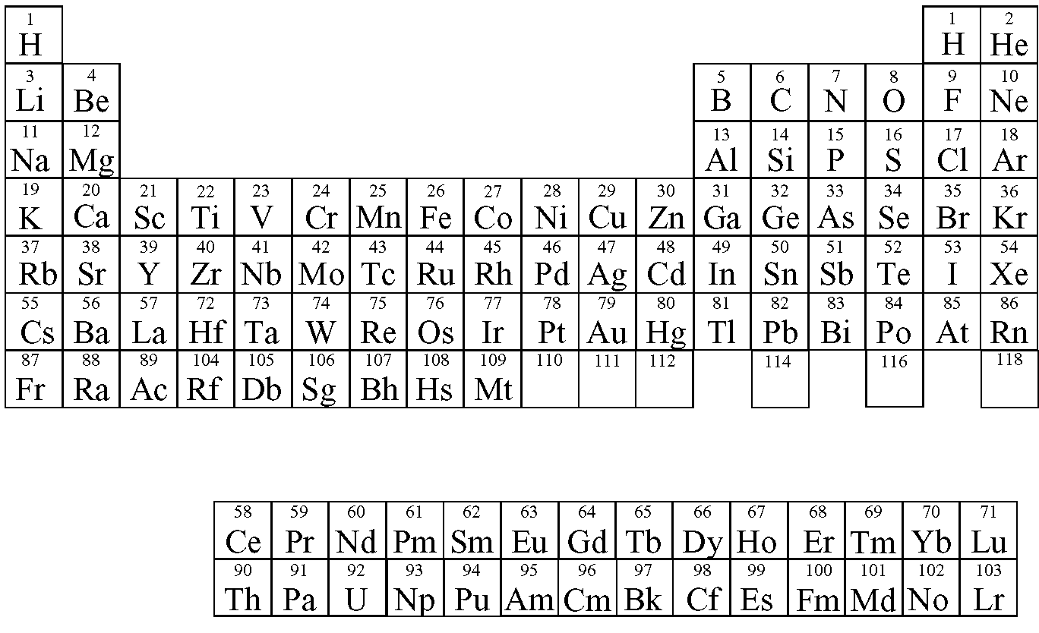
Viable nuclei for anapole/NSD-PV measurement with ZOMBIES
10% measurement possible with demonstrated sensitivity, 100 h data
Requires systematics ~2-10x better
Statistics likely OK, will require systematics ~100x better

Slide 51
Beyond ZOMBIES: next-gen NSD-PV measurements with light nuclei
See Ronald Garcia-Ruiz plenary talk this morning
Towards measurements of symmetry-violating nuclear properties using single molecular ions in a Penning trap J Karthein, D DeMille, J Dilling, R Garcia Ruiz, N Hutzler, P Mohapatra, Scott Moroch, Ryan Ringle, Silviu-Marian Udrescu Bulletin of the American Physical Society 66 2021
MUCH longer interaction time, MUCH smaller experimental volume, very advanced techniques w/single ions in Penning traps
→
MUCH better sensitivity (sufficient for p,d…?) AND
ability to probe short-lived radioactive isotopes

Slide 52
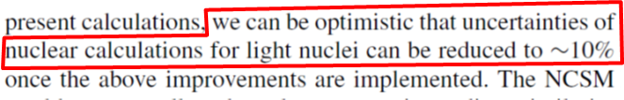
First glimmers: reliable HPV→NSD-PV calculations in nuclei?
First No-Core Shell Model calculations of anapole moments and V_{e}A_{N} effects
Significant differences from single-particle SM estimates
Magnetic moment as benchmark

Slide 53
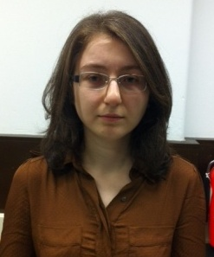


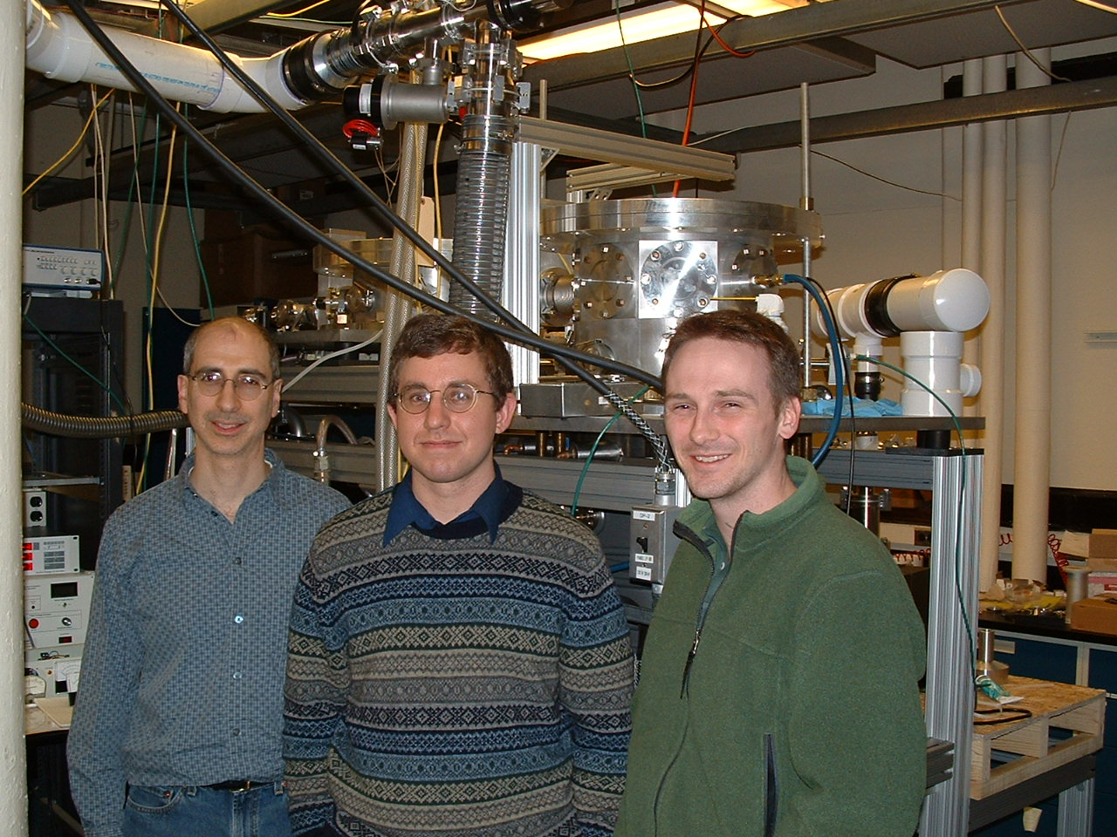
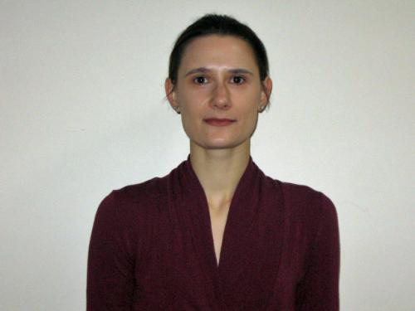

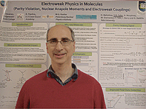


ZOMBIES Past & Present
David Rahmlow,
Dennis Murphree
Dr. Emil Kirilov
Dr. Max Beyer
Emine Altuntas
Jeffrey Ammon
Dr. Yulia Gurevich
Sidney Cahn
(Yale)
Sidney Cahn
(Yale)
Dr. Mangesh Bhattarai
Tanvi Deshmukh

Slide 54
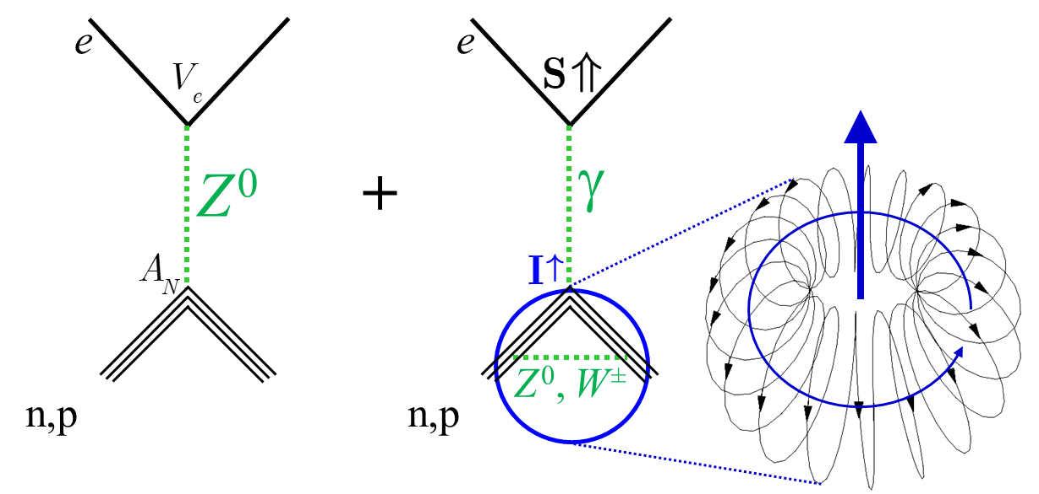
ZOMBIES: Summary & Outlook
--New era in NSD-PV: anapole + V_{e}A_{N} measurements beginning
--Sensitivity & accuracy of molecular systems likely to enable measurements on many nuclei, including lighter isotopes, with <10% uncertainty
--Complementary to other hadronic PV experiments & SoLID/PVDIS @ JLab
--NSD-PV poised to open new window to unified understanding of hadronic PV & semileptonic neutral-current PV, in strongly-interacting environment, across wide range of scales

Slide 55
Extra Slides

Slide 56
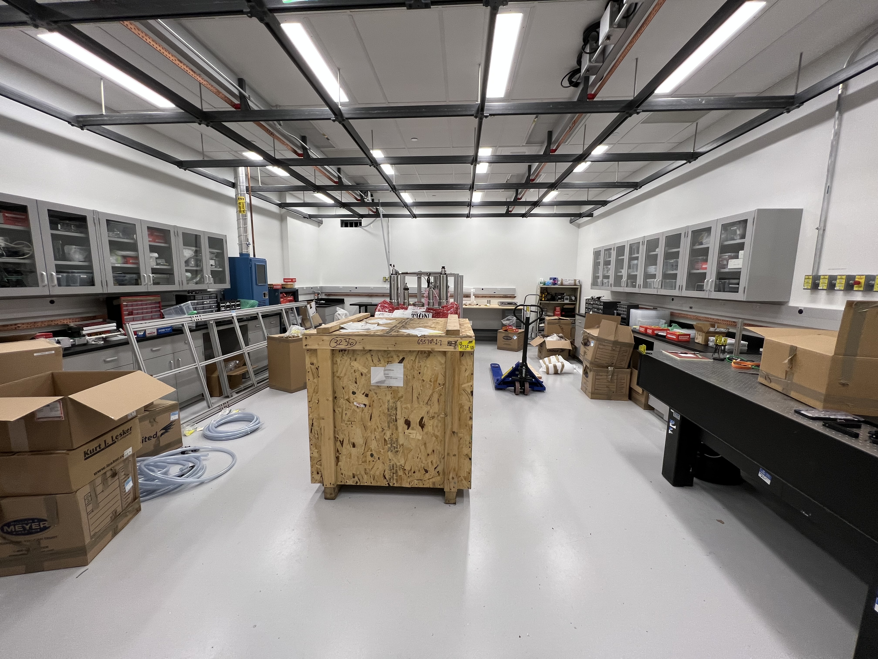
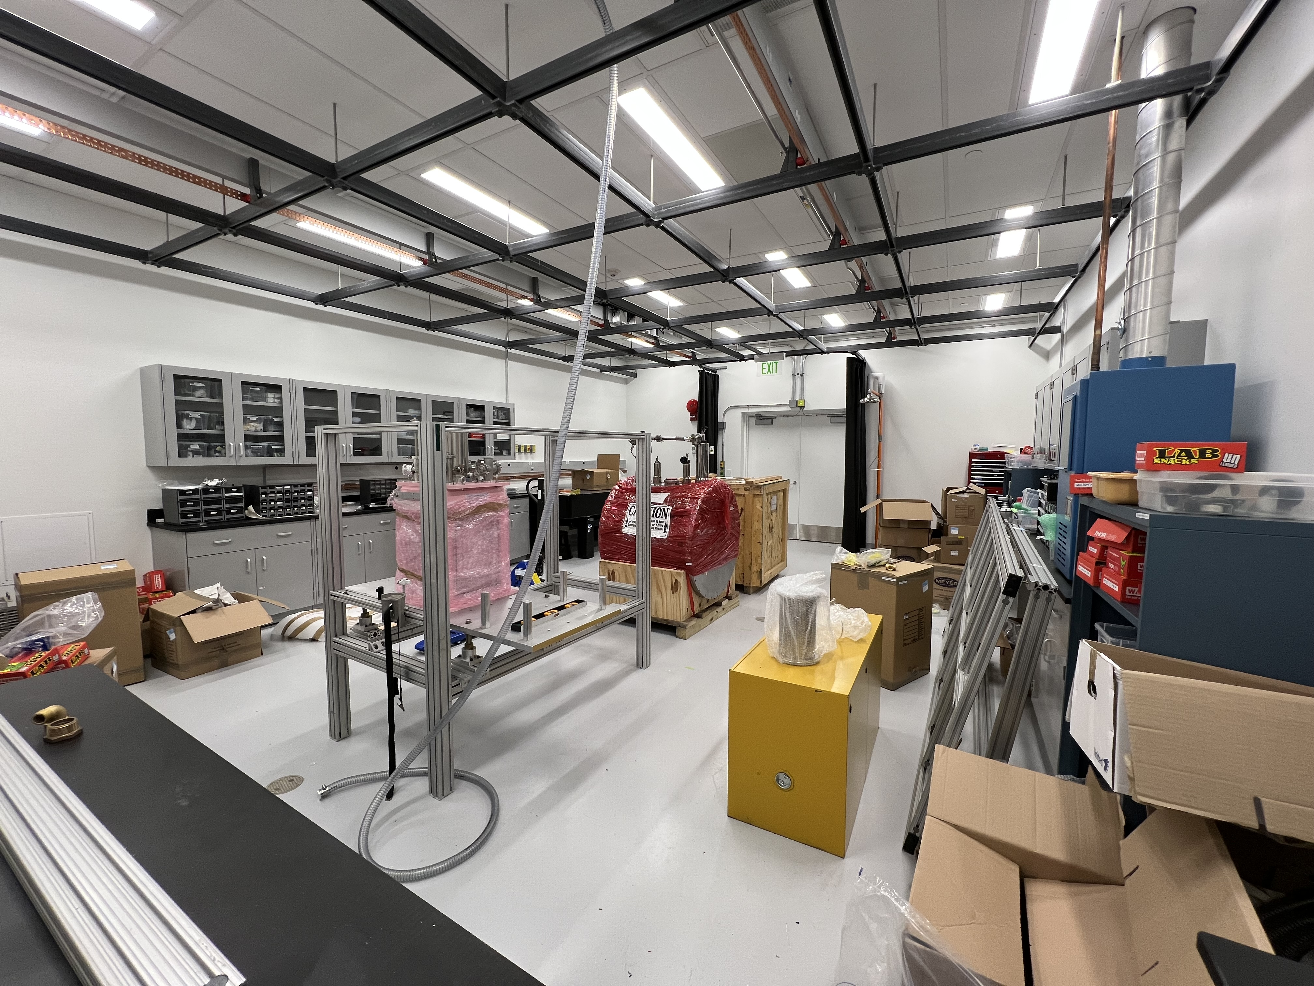
ZOMBIES Re-assembly Underway at Argonne!

Slide 57
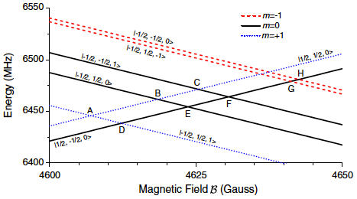
Different level crossings to suppress systematics
|m_{S}, m_{I}, m_{N} >
S: electron spin
I: nuclear spin
N: rotation
n: molecular axis
Measured quantity,
different for
each crossing
NSD-PV parameters:
same at all crossings
Angular factor:
Different for each crossing (sign & magnitude)
Analytically calculable
Molecular wavefunctions:
same at all crossings,
accurately computed

Slide 58
Ongoing or proposed anapole-sensitive experiments with atoms
Mainz: ¹⁷¹Yb, ¹⁷³Yb atoms (similar to JILA Cs experiment)
FrPNC @ TRIUMF: ^{xxx}Fr atoms (laser cooled & trapped)
Mainz: new ideas using NMR signals for light nuclei….?
Mainz + ANL: use CeNTREX apparatus in different mode (AC E-field)…?

Slide 59
Mechanisms for atomic/molecular parity violation
Axial electron-vector nucleon interaction
e
A_{e}V_{N} interaction → atomic Hamiltonian
e
V_{e}+A_{e}
V_{e}+A_{e}
Z⁰
Z⁰
axial vector
associated with electron
short-range
Yukawa potential
V_{N}+A_{N}
V_{N}+A_{N}
Q_{W} measured to 0.4% [C. Wieman group, 1997]
& interpreted at 0.3% level [A. Derevianko 2010, V. Flambaum 2012, …]
Running of sin²θ_{w} &
Limits on Z’ bosons
N
N
Coherent coupling to all nuclei =
“weak charge”
Q_{W} = -N +(1-4sin²θ_{W})Z

Slide 60
Mechanisms for atomic/molecular parity violation
Vector electron-axial nucleon interaction
e
e
V_{e}A_{N} interaction → Hamiltonian:
V_{e}+A_{e}
V_{e}+A_{e}
Z⁰
Z⁰
Nuclear spin I
= axial vector
associated with nucleon
V_{N}+A_{N}
V_{N}+A_{N}
N
N
C₂ numerically small: V_{e}/A_{e} = (1-4sin²θ_{W}) ~ .08
Coupling ONLY to unpaired nucleon
coupling constant C₂
Bottom line:
V_{e}A_{N} /A_{e}V_{N} ~10⁻³
(for heavy atoms)

Slide 61
Anapole moments in DDH parameterization

Slide 62
3 contributions to NSD-PV: scaling with Z & A
Overall Z²
κ’_{2P} = -κ’_{2N}
≅ -g_{A} (1-4sin²θ_{W})/2 ≅ -.05
~independent of A
O(20%) corrections from SU(3)_{f}
O(100%) expt. uncertainty
Quenching in larger nuclei like g_{A}?
κ’_{Q} ∝ A^{2/3} small (<κ’_{a} /4) & well understood --ignore
Simple shell model:
valence nucleon over closed core

Slide 63
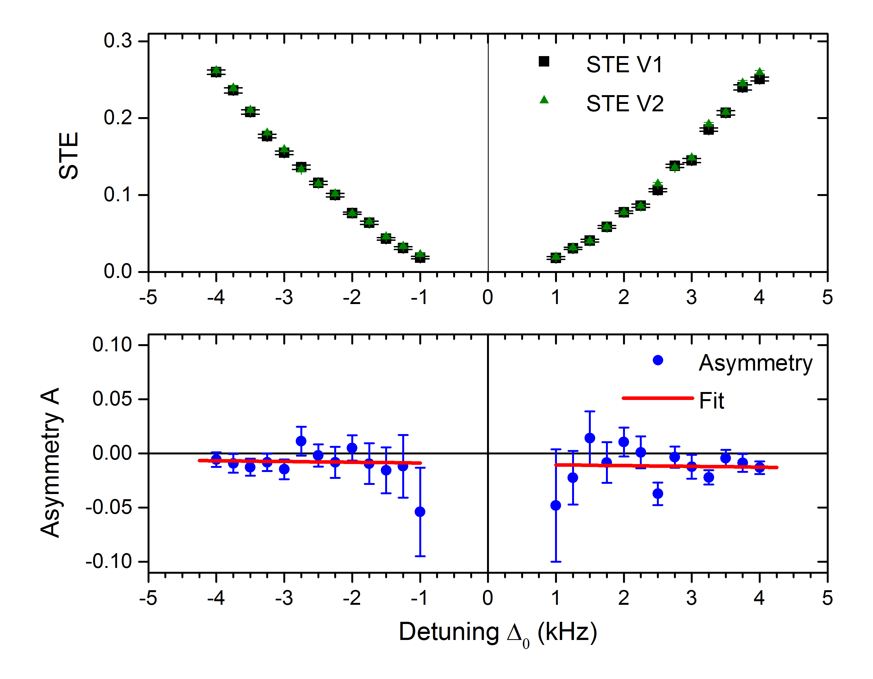
NSD-PV data with ¹³⁸Ba¹⁹F
Measure, cancel, & remeasure B-field gradients and non-reversing E-fields to suppress possible systematics
Measure NSD-PV signal & asymmetry
Fit to function

Slide 64
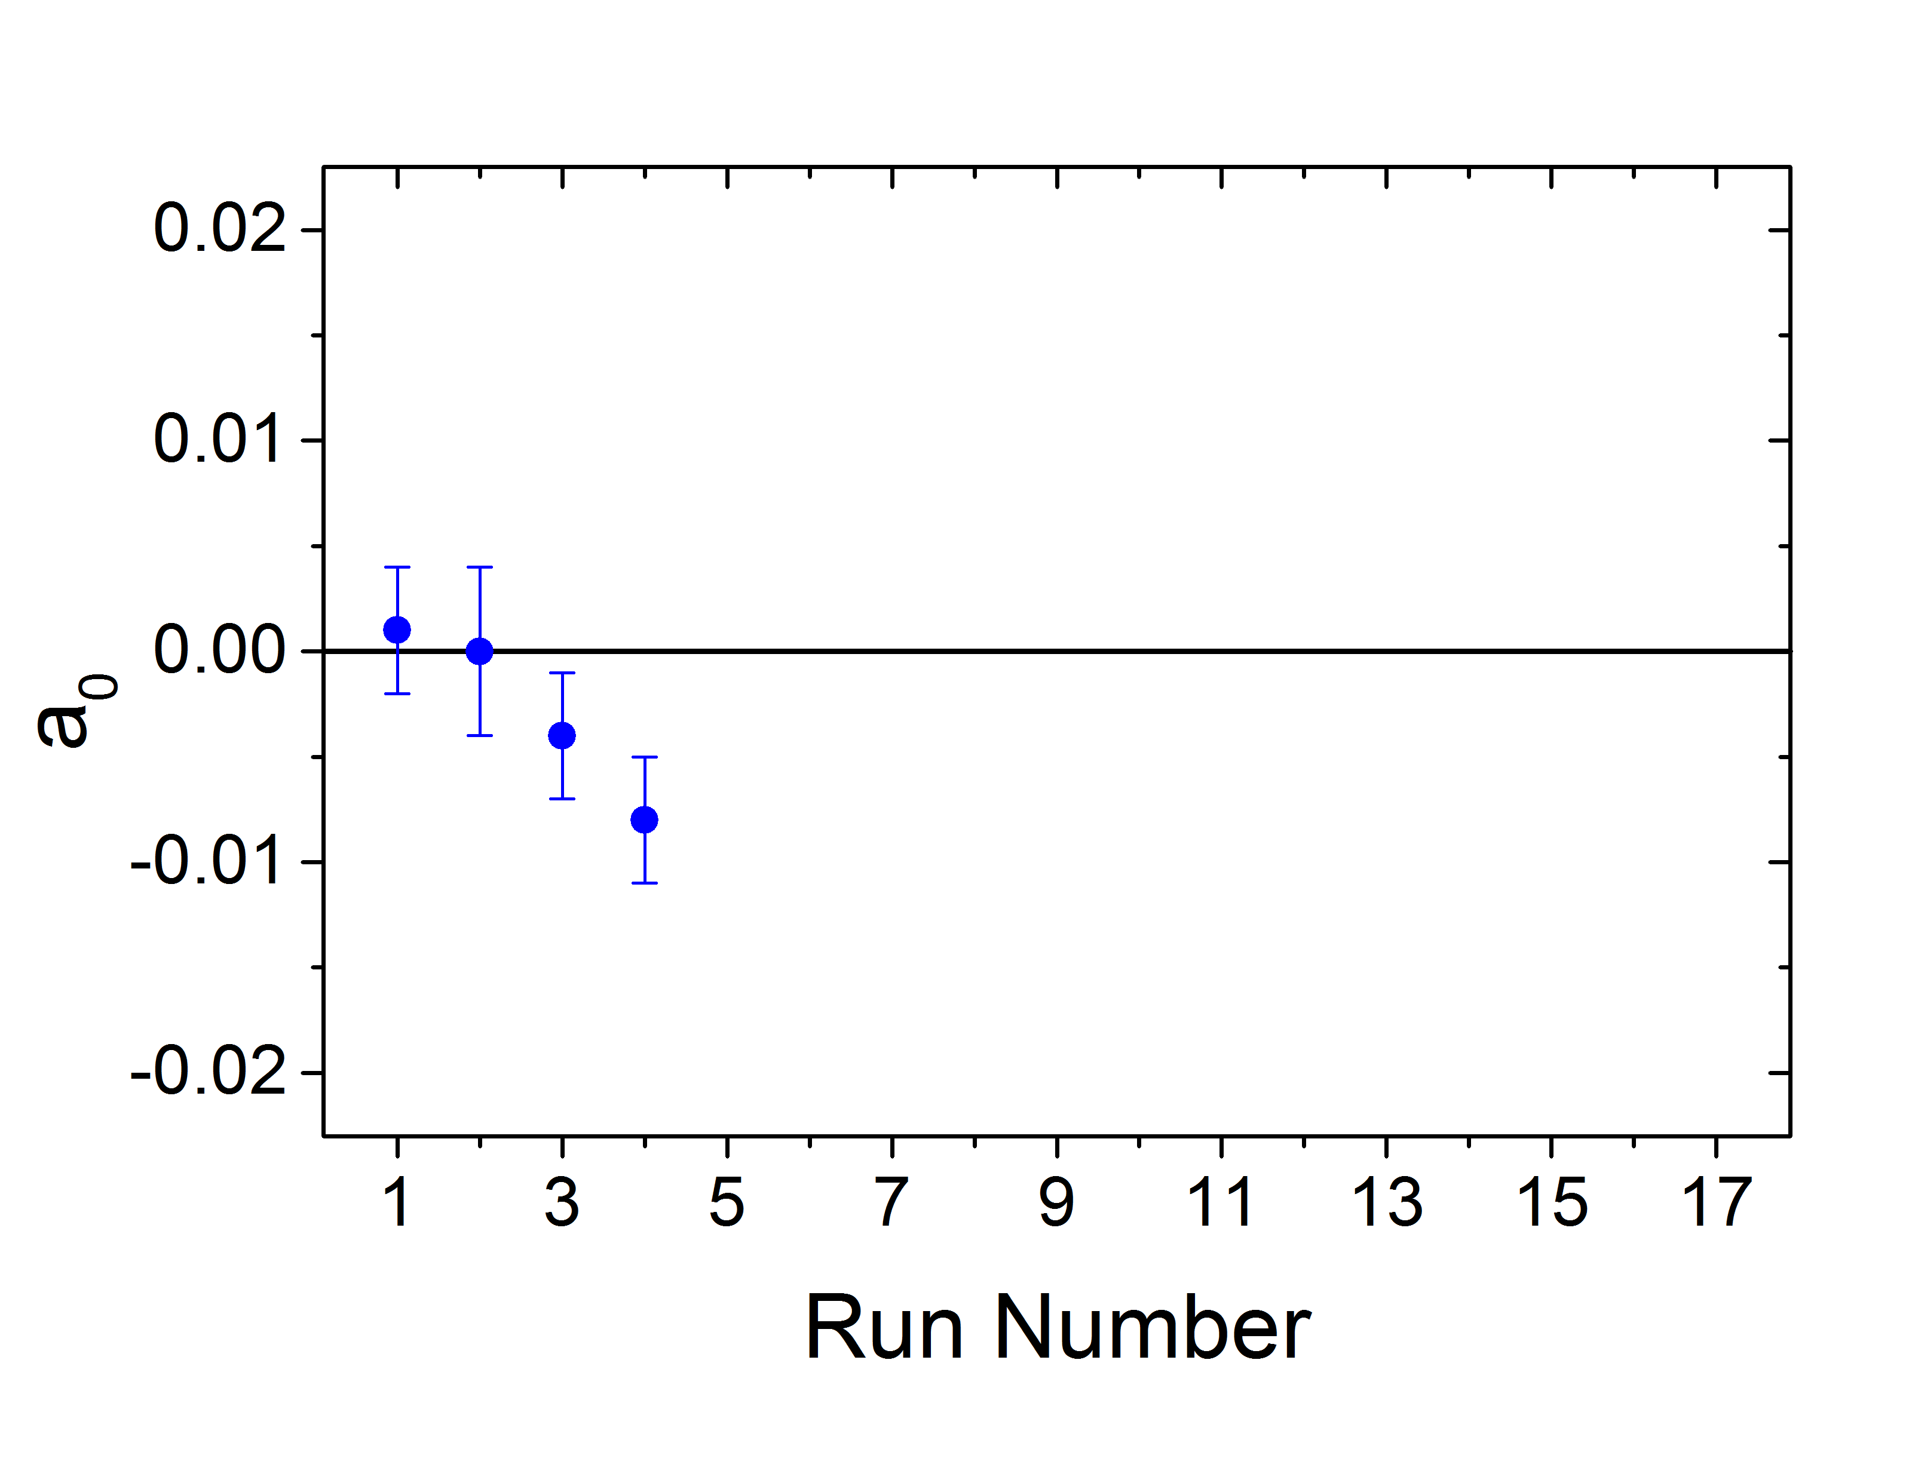
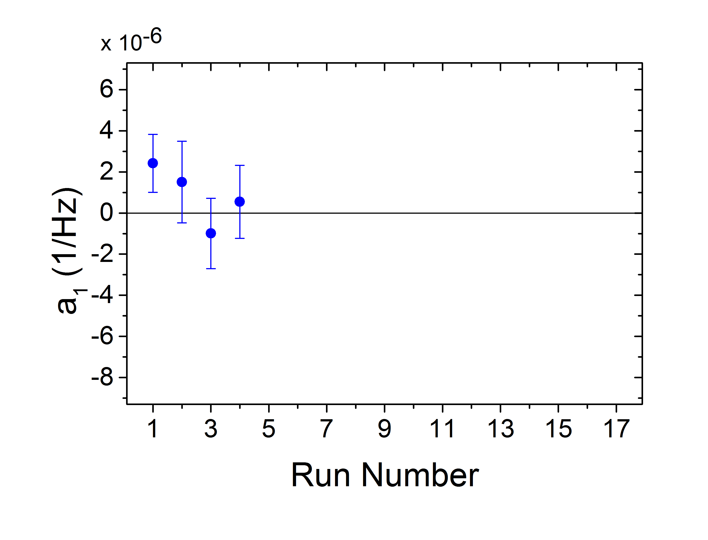
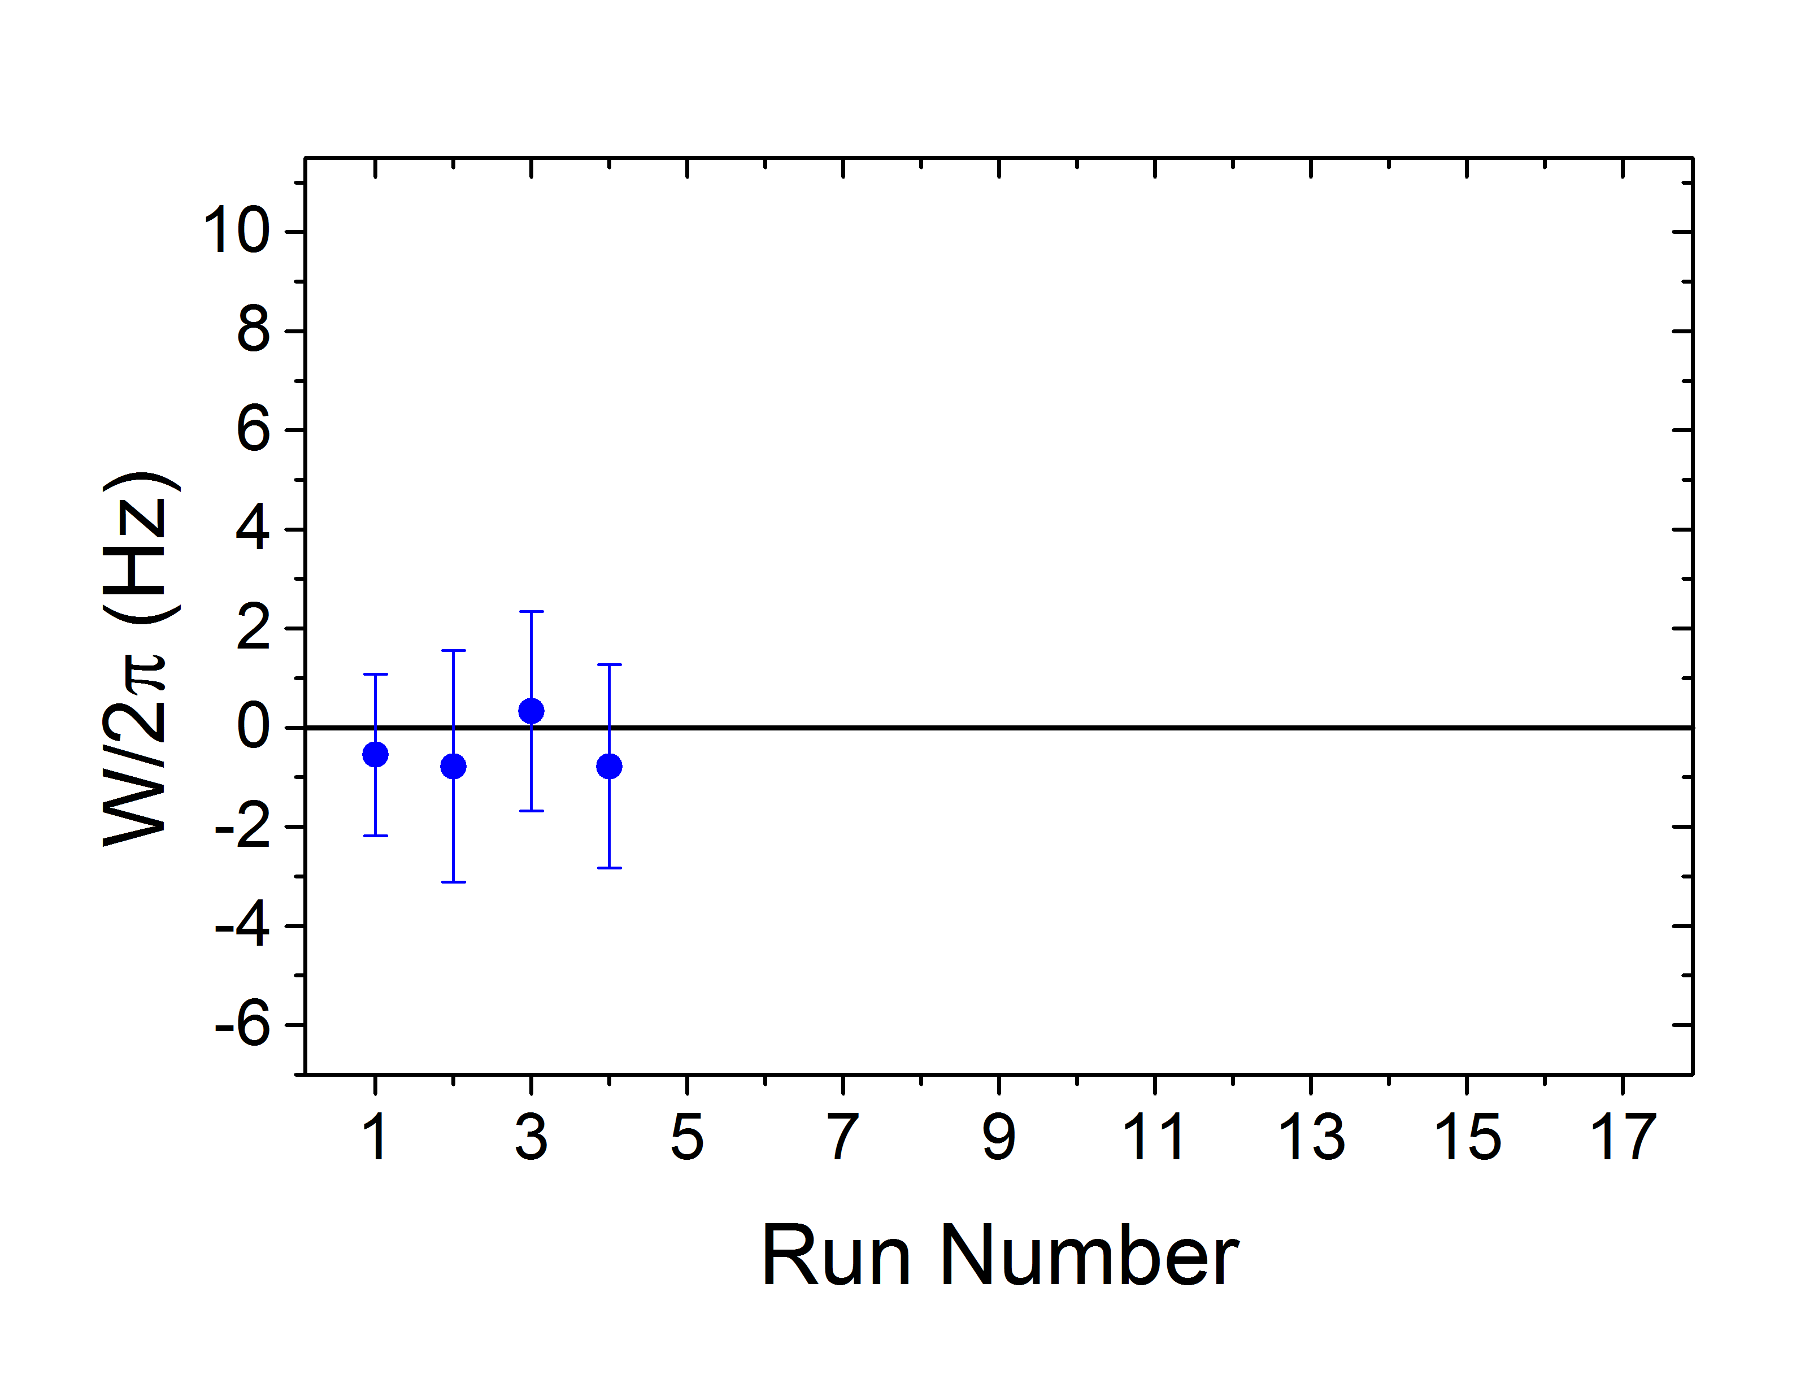
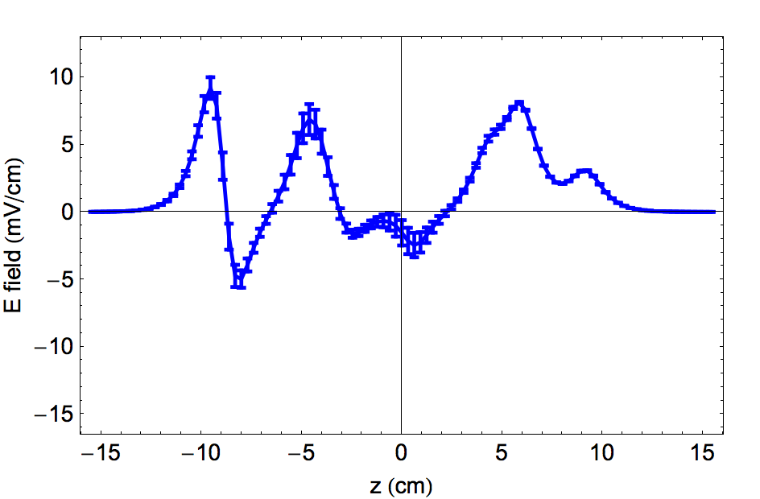
NSD-PV data with ¹³⁸Ba¹⁹F
Fit to
From combined stray E-fields & B-field gradients
from stray E-fields alone
NSD-PV
stray E-fields always below 15mV/cm

Slide 65
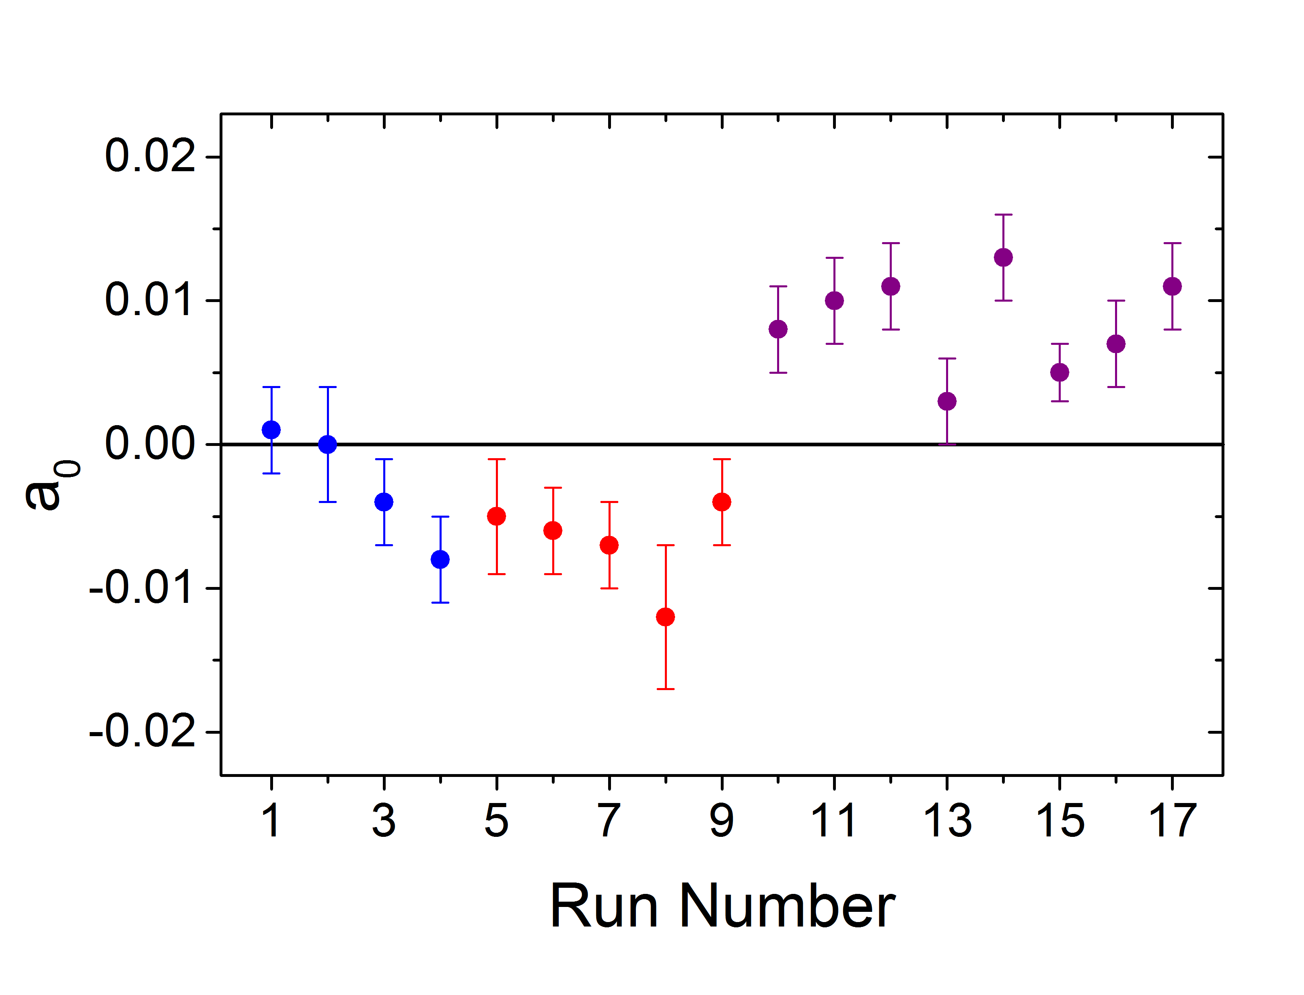
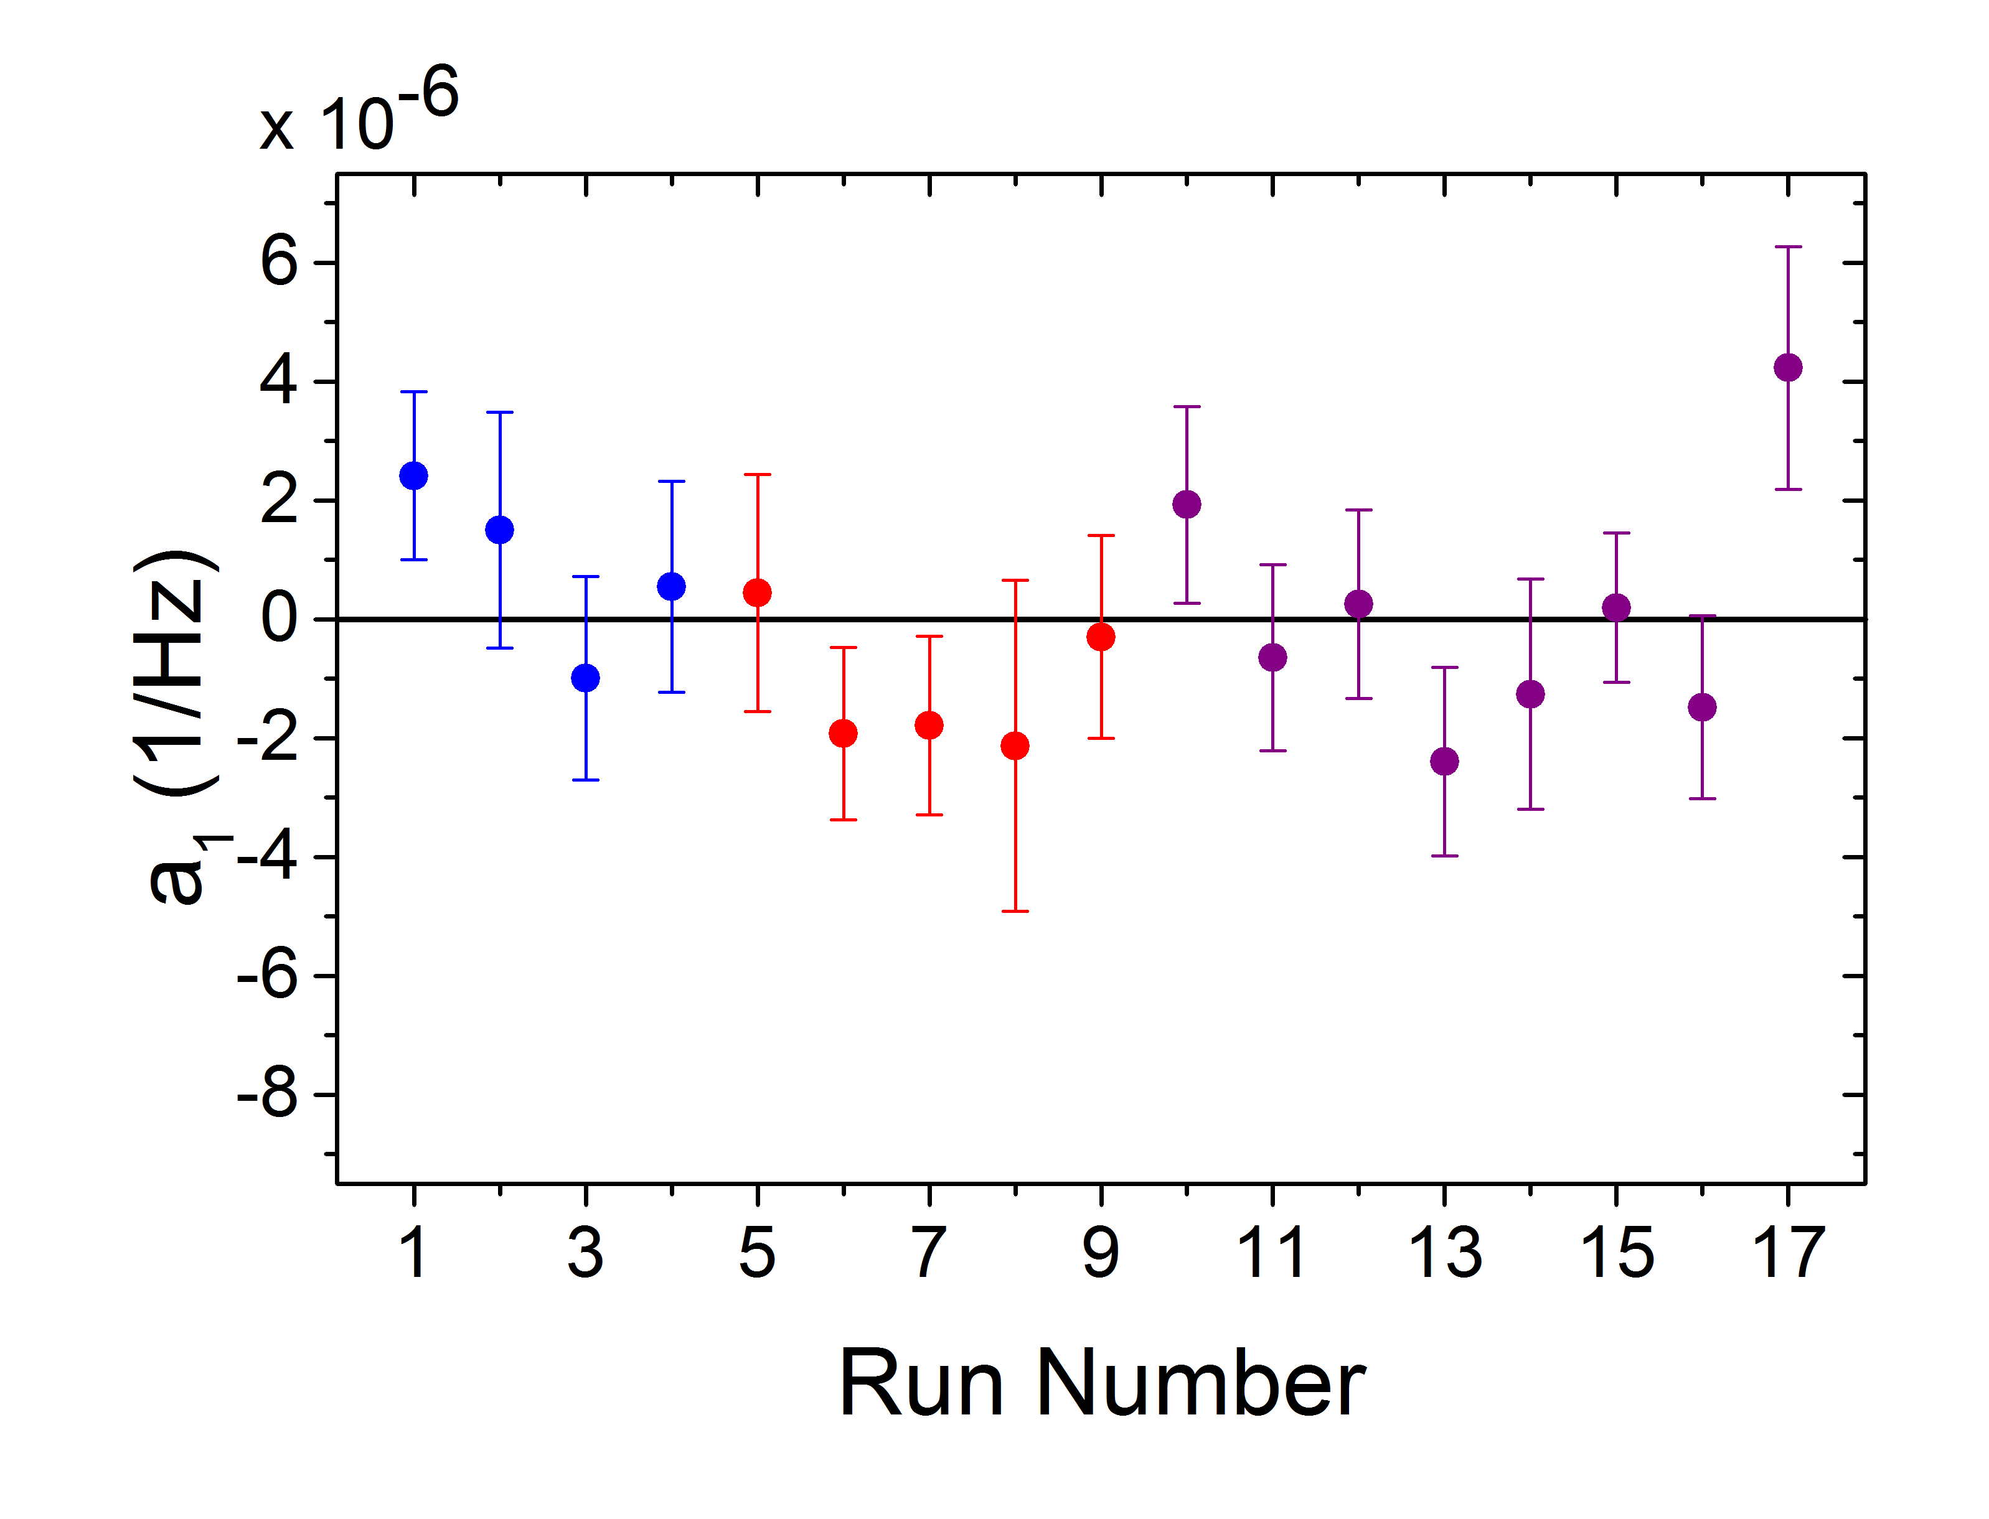
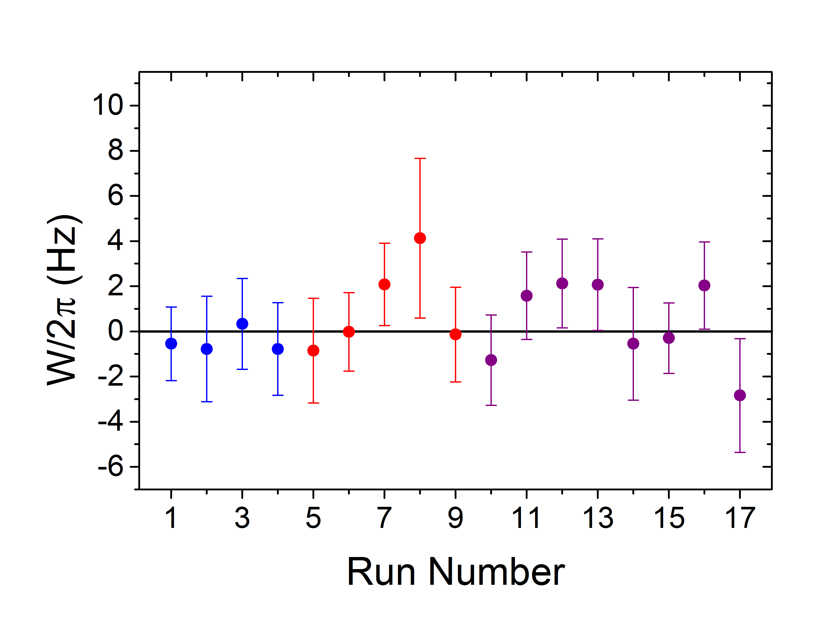
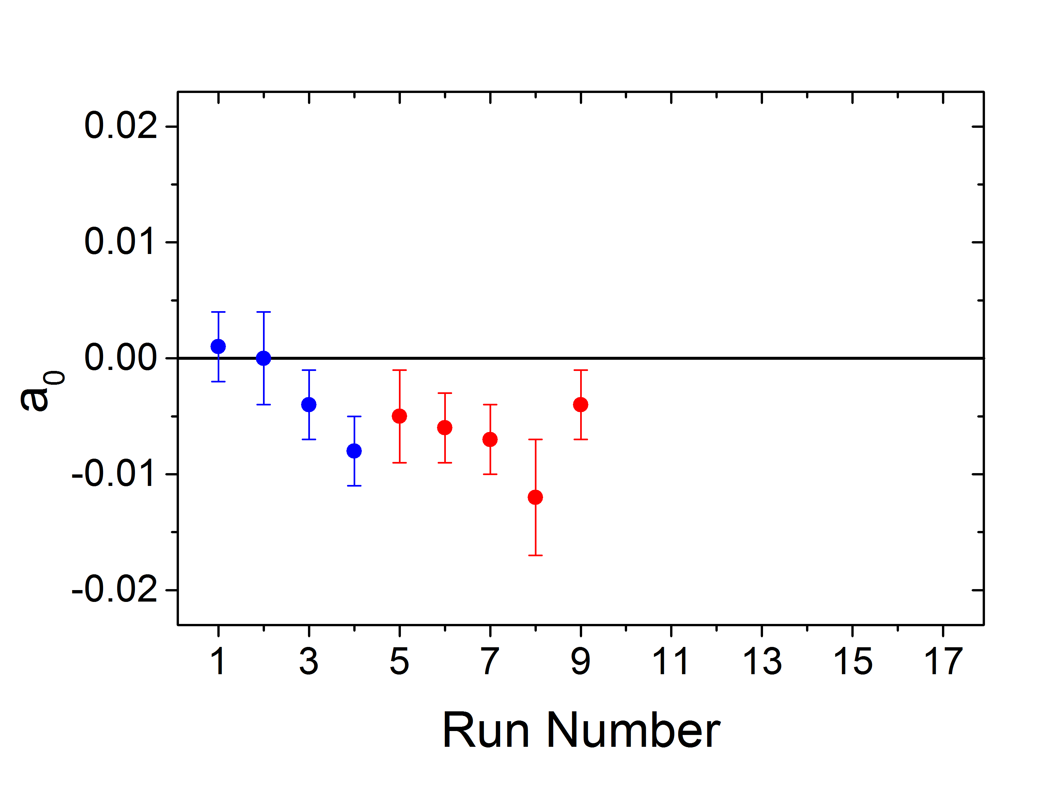
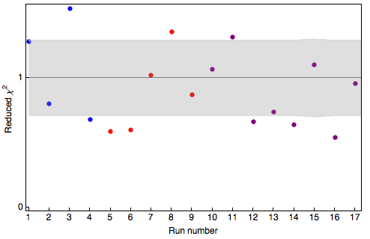
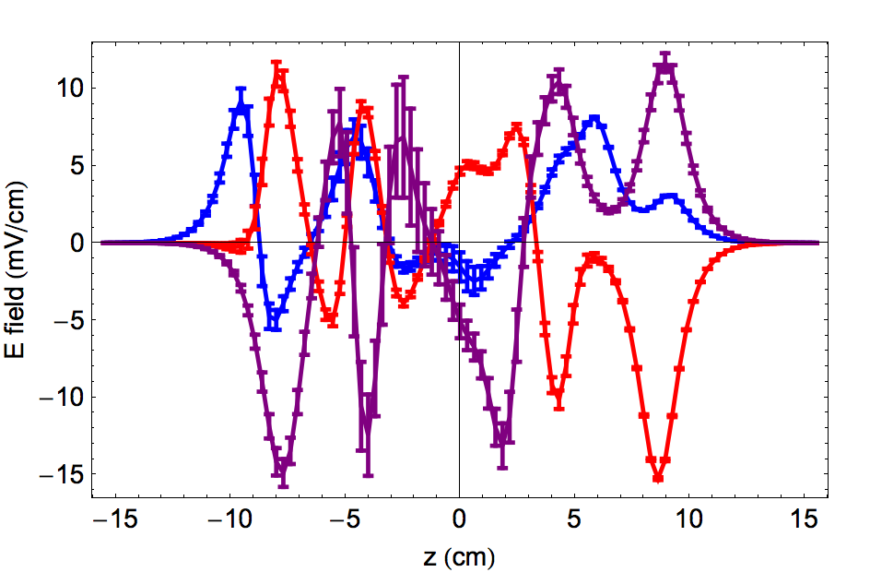
NSD-PV data with ¹³⁸Ba¹⁹F
¹³⁸BaF expected W = 0
Measured with 3 different stray E-fields (all below 15 mV/cm)
a₁ terms consistent with zero: no systematics

Slide 66
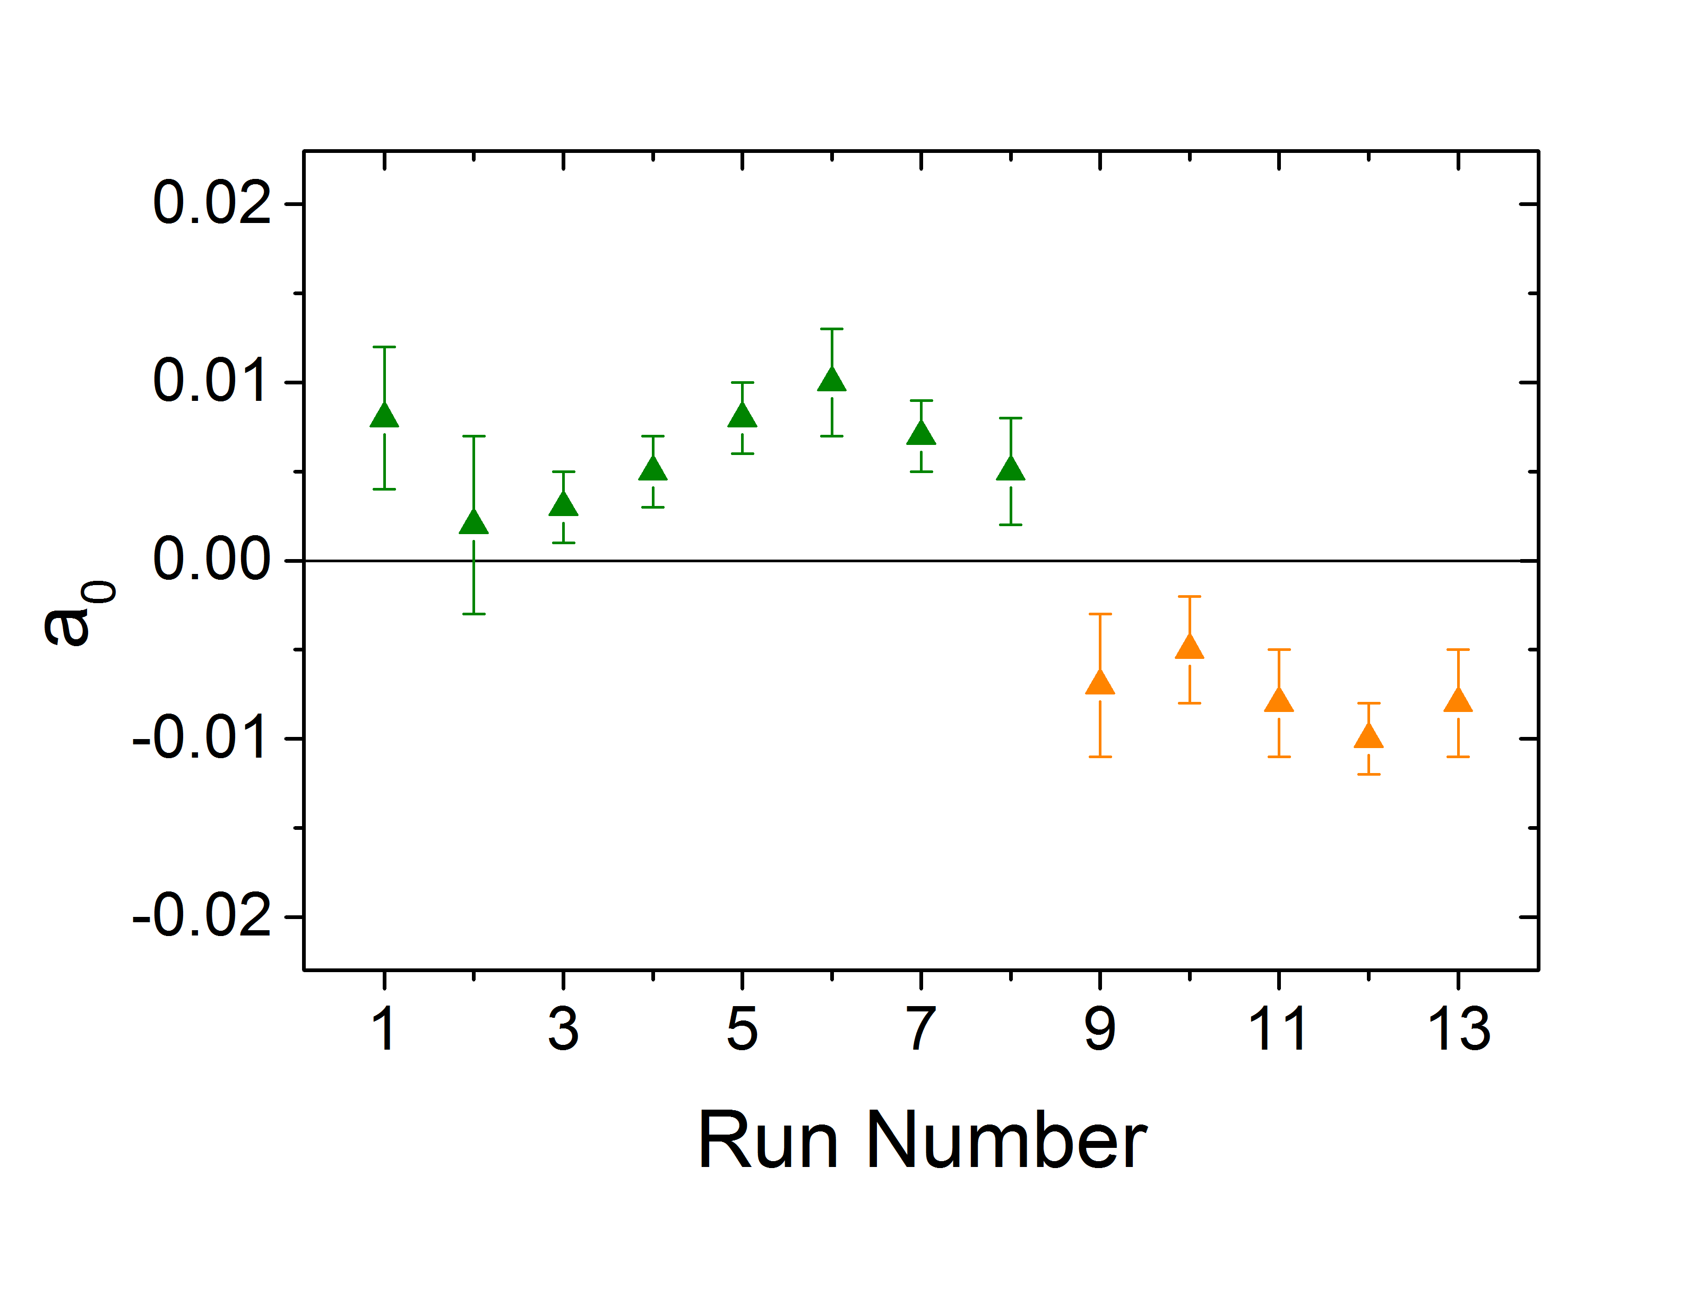
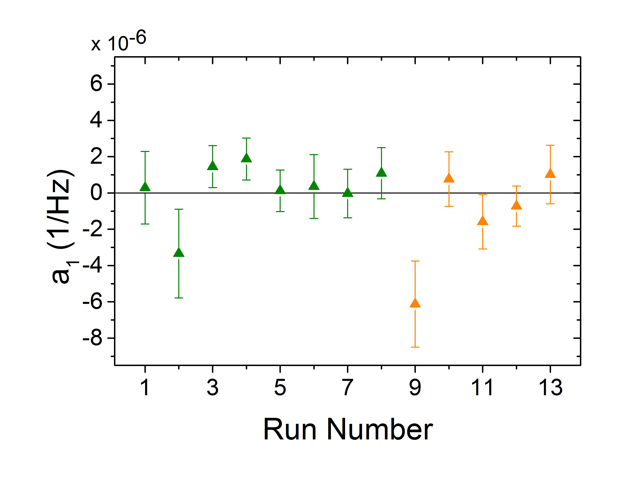
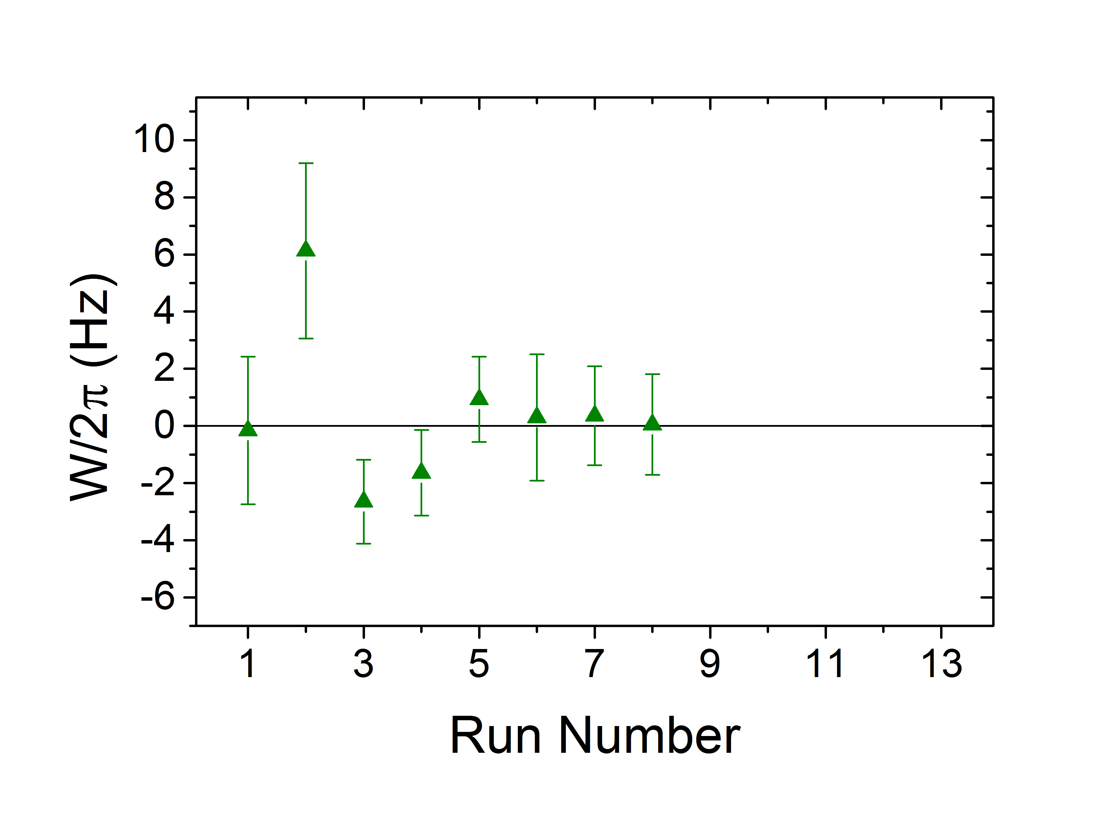
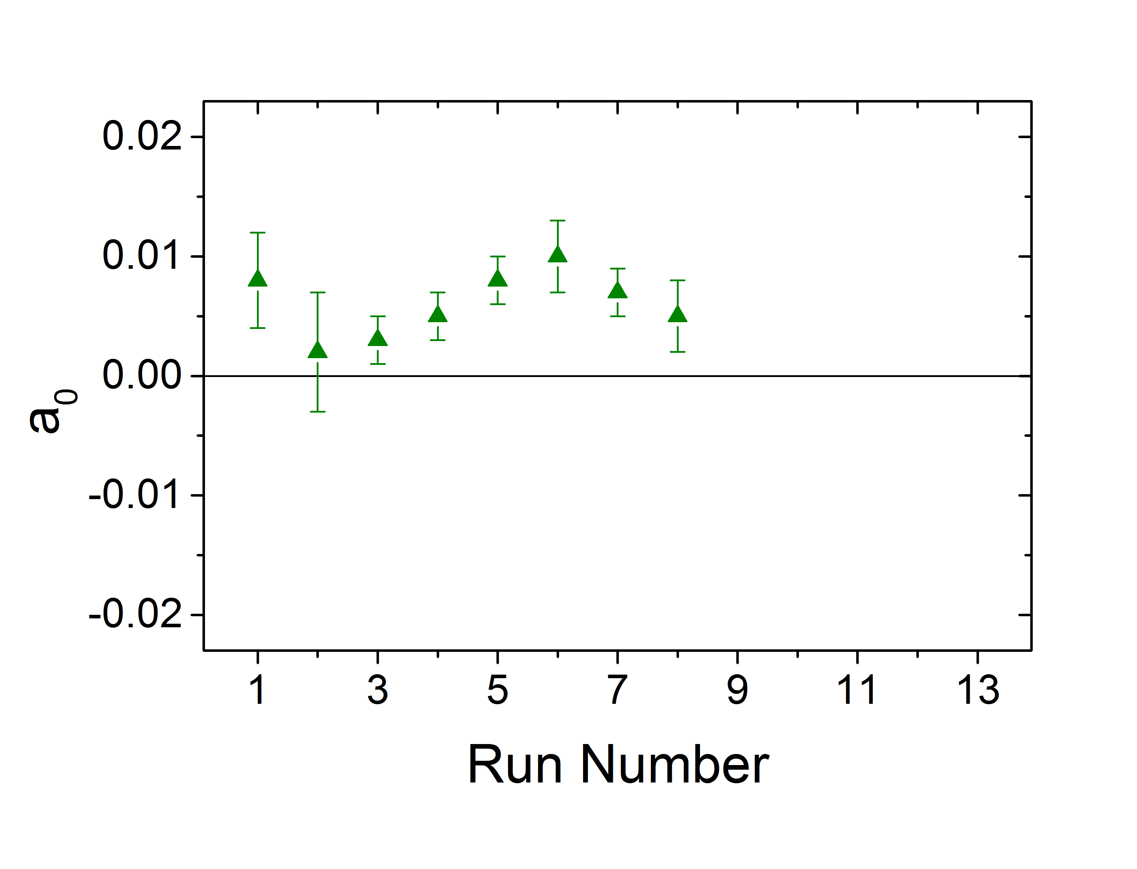
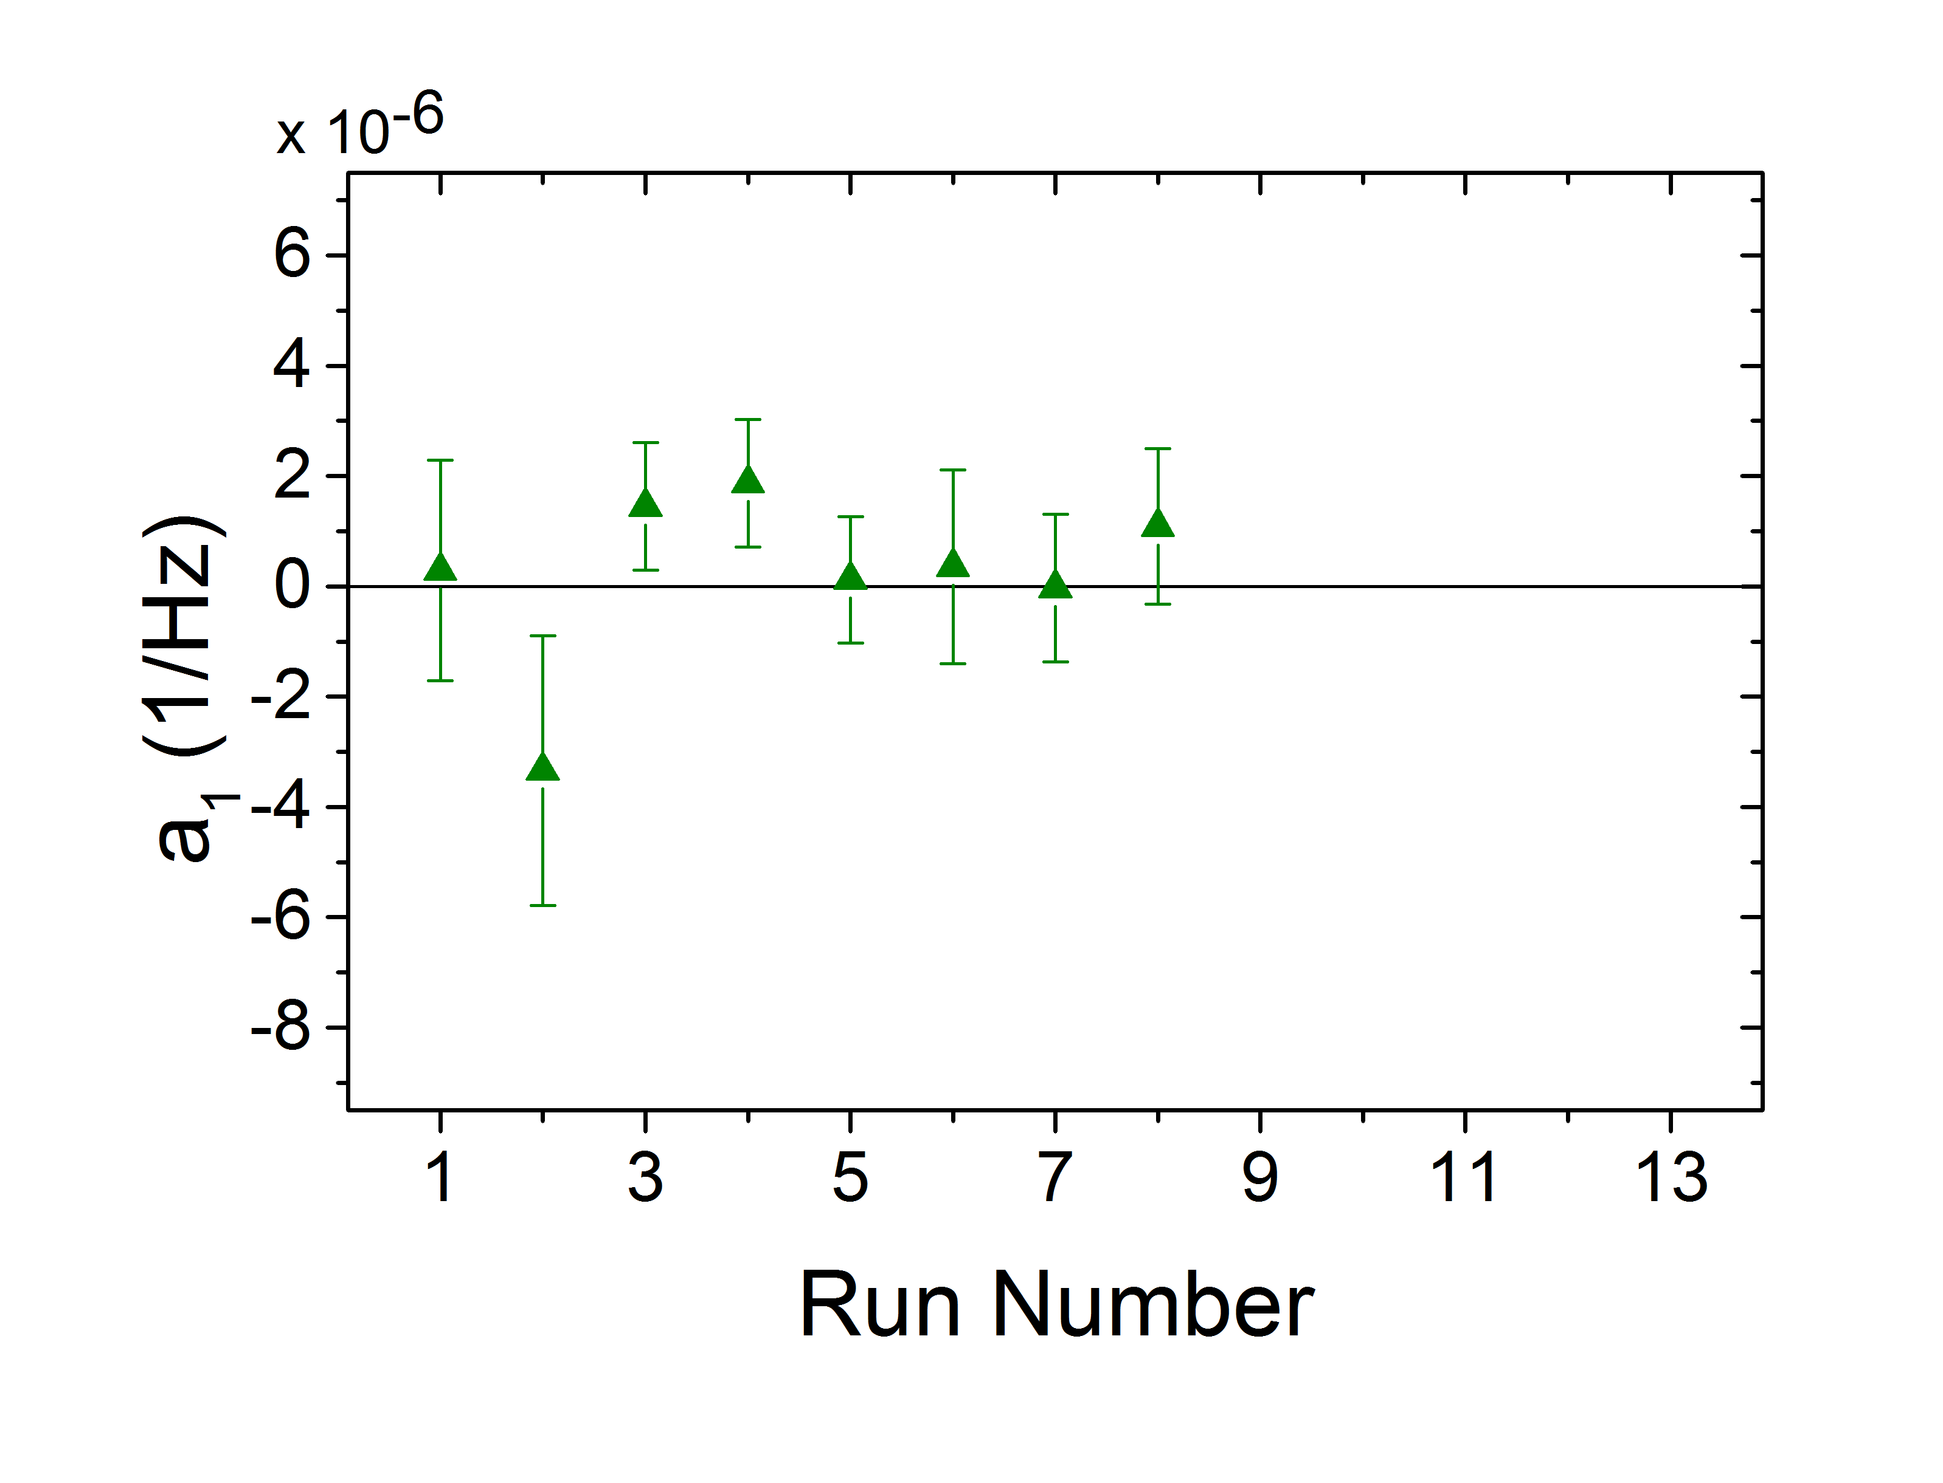
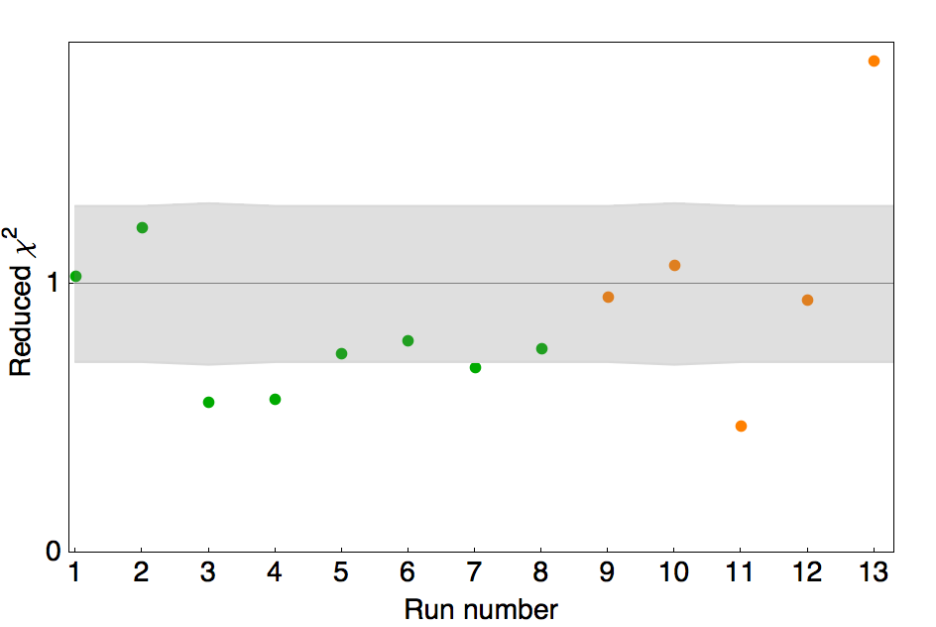
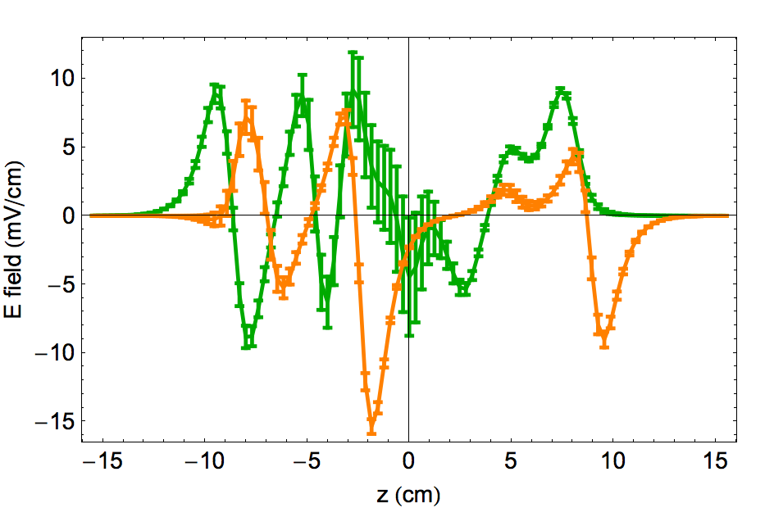
NSD-PV data with ¹³⁸Ba¹⁹F: 2nd crossing W→-W
¹³⁸BaF expected W = 0
Measured with 2 different stray E-fields (all below 15mV/cm)
No systematics → a₁ terms consistent with zero

Slide 67
Recent PV data with ¹³⁸Ba¹⁹F
Proof of concept run (null signal expected for ¹⁹F nucleus)
Avg. over ~30 hours:
W/2π = -0.03±0.47 Hz
⇒ consistent w/ zero
Typical data with
Offset = 0.006±0.001
(from small stray E-field)
χ²_{d.o.f.} = 0.66
Statistical uncertainty δW = 0.5 Hz [~30 hours data]
~60× more sensitive than best atomic experiment (Wieman, ¹³³Cs)
Sufficient to measure effect in many heavy nuclei & several light nuclei w/anticipated technical upgrades
Notes:
Use best recent data!

Slide 68
Questions/requests for theorists
--Calculations with new HPV parameterization
--Calculate lightest nuclei (accessible via no-core shell model…?)
--Quantitative uncertainties on calculations!
--Could C₂ values be extracted reliably from light nuclei with existing HPV data & understanding?
--Is consistency check between isotopes in heavier nuclei useful? --special cases of particular interest? (e.g. ¹⁹F… can it be calculated accurately?)
--Can anapole measurements (with known inputs) shed light on other related calculations e.g. Schiff moment, 0νββ decay, …?
--Generally: modern theory perspective on anapole moments URGENTLY needed (>10 years since last nuclear theory paper)

